Slide 1



Weekly Review
Gobind Sugar Mill, Aira
25th Oct. to 31th Oct. 2025

Slide 2

SPE Weekly Snapshot
Production Parameters | Current Week | Last Week | Till Date
Total Sugarcane Crush (LQ) | 4.25 |  | 4.25
Sugar Recovery | 9.00% |  | 9.00%
Cane for Syrup (LQ) | 0.87 |  | 0.87
Sugar Produced (LQ) | 0.12 |  | 0.12
Ethanol Produced (LL) | 1.86 | 1.38 | 9.60
Power Generation (LU) | 44.69 |  | 44.69
Power Export (LU) | 29.80 |  | 29.80
Cane Payment (Cr) | - |  | -
Capacity Utilization | Current Week | Last Week | Till Date
Season Days | 6 |  | 6
Milling PUF | 70.90% |  | 70.90%
Sugar Bagging (Nos.) Actual/Capacity | 59015/ 56580 | 64056/ 58862 | 326138/ 330405
Power PUF | 77.59 % |  | 77.59 %
Distillery PUF | 100.72% | 76.82% | 71.95%
Total Pol Losses | 1.88% |  | 1.88%
Bagasse Moisture | 50.52% |  | 50.52%
2

Slide 3
SPE Weekly Snapshot – Total Losses
This Week | Last Week | Till Date
1.88 |  | 1.88
3
Notes:
Pol in Cane

Slide 4
Production & Sales (Budget vs Actual)
Production (F.Y. 2025-26)
Particulars | Current Month (Oct,25) |  | Last Month (Sep,25) |  | YTD Till Last Month (Up to Sep,25)
 | Budgeted | Actual-till 31st Oct, 25 | Budgeted | Actual | Budgeted | Actual
Sugar (LQ) | 0.33 | 0.12 | - | - | - | -
Power (LU) | 67.20 | 55.38 | 14.59 | 20.75 | 138.74 | 127.64
Ethanol (LL) | 13.20 | 9.60 | 22.11 | 27.75 | 192.51 | 187.03
 |  |  |  |  | Oct.25 | 9.60
 |  |  |  |  | Et.Total Up to Oct.25 | 196.63
Sales (F.Y.2025-26)
Particulars | Current Month (Sep ,25) |  | Last Month (Sep,25) |  | YTD Till Last Month (Up to Sep,25)
 | Budgeted | Actual till 31st Oct, 25 | Budgeted | Actual | Budgeted | Actual
Sugar (LQ) | 1.29 | 1.22 | 1.30 | 1.24 | 7.40 | 7.26
Power (LU) | 43.61 | 33.09 | 0.66 | 2.93 | 12.96 | 18.99
Ethanol (LL) | 13.20 | 22.78 | 22.11 | 20.81 | 192.51 | 174.62
 |  |  |  |  | Oct.25 | 22.78
 |  |  |  |  | Et.Sale Up to Oct.25 | 197.40
Notes:
Ethanol Production during week 25.10.25 to 31.10.25- 1.86 Lac B.L.& Sale-Nil

Slide 5
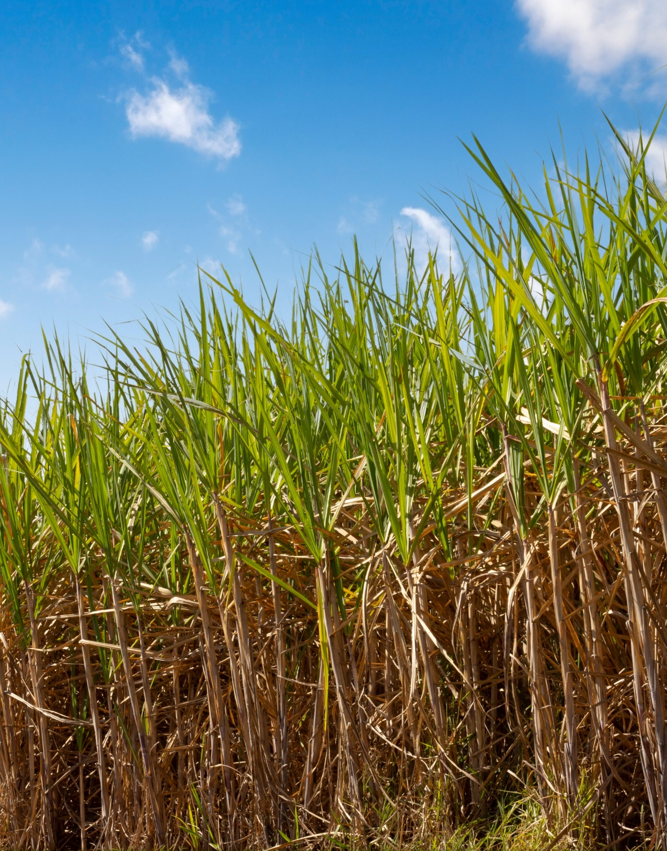
CANE

Slide 6
Weekly Performance Snapshot – Cane
S. No. | Capacity Utilization | Target | Current Week | Last Week | Till Date
1 | Daily Indent Rate Avg. (LQ) | As per requirement | 1.56 | NA | 1.56
2 | Daily Cane Purchased Rate (LQ) | 1.00 | 0.43 | NA | 0.43
3 | Gate Indent Maturity (%) | NA | 50% | 0 | 50%
4 | Center Indent Maturity (%) | NA | 65% | 0 | 65%
5 | Pol in Cane (%) | 13.80 | 10.89 | 0 | 10.89
6 | Middle Brix from Yard Sampling (%) | NA | 16 | 0 | 16
7 | Affected Cane % (from Yard Sampling) | NA | 0 | 0 | 0
8 | Avg. Center Cane Holding Time (Hrs.) | NA | 16.68 | 0 | 16.68

Slide 7
Indent, Yard Balance Vs Crushing (Lakh Qtls.) (31.10.25)

Slide 8
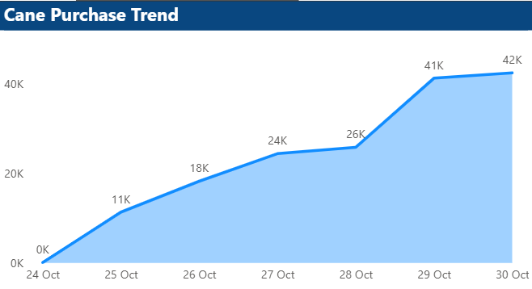
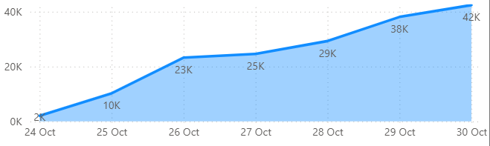
Cane Purchase trend for the week (Period)
Cane Purchase Trend - Gate
Cane Purchase Trend - Centers

Slide 9
PoL Vs Recovery % (Period)

Slide 10
Historical Recovery Trend Vs Current (Last 5 years)

Slide 11
Indent Maturity
Top 10 Centers
S.No. | CENTRE NAME | SOCIETY NAME | INDENT (QTL) | MATURITY %
1. | KATHOUTIYA | NANPARA | 2817 | 67.3%
2. | MATHIYA PURWA | LAKHIMPUR | 4986 | 60.5%
4. | SISAIA-II / SUJAIKUND | AIRA | 5652 | 58.0%
5. | SAJANI | LAKHIMPUR | 4815 | 52.5%
6. | AMETHI - I | AIRA | 3366 | 54.0%
7. | KATKUSMA | LAKHIMPUR | 4257 | 53.0%
8. | DANDOORI | BELRAYA | 5335 | 59.0%
9. | CHAMHALPUR (ARNI) | LAKHIMPUR | 486 | 65.1%
10. | BASANTAPUR / DHAURAHRA | AIRA | 8172 | 62.9%
Notes:
Good: >= 90% Average: >=70% and <90% Poor: <70%

Slide 12
Indent Maturity
Bottom 10 Centers
S.No. | CENTRE NAME | SOCIETY NAME | INDENT (QTL) | MATURITY % | Reason
1. | KHAJUHABAZAR III | AIRA | 2178 | 6.9 | Flood affected
2. | GATE (MAHMOODABAD) | MAHMOODABAD | 3528 | 8.1 | Flood affected
3. | JUNGLE MATERA | AIRA | 810 | 8.1 | Bad road
4. | NAYANPUR - III | AIRA | 4068 | 8.8 | Flood affected
5. | MILIK / KHAJUHABAZAR | AIRA | 1681 | 9 | Flood affected
6. | KIRATIPURVA - IV | AIRA | 1359 | 9.3 | Late operated
7. | MISHIRGAON | AIRA | 2268 | 9.3 | Labour problem
8. | DHARAMPUR SEMRI | NANAPARA | 1431 | 9.4 | Transport problem
9. | DURGAPUR PADARI | AIRA | 2619 | 9.9 | Labour problem
10. | KATUALI | AIRA | 2322 | 10.2 | Transport
Notes:
Good: >= 90% Average: >=70% and <90% Poor: <70%

Slide 13
Average Vehicle Holding time at Purchase Center
Top 10 Centers
S. No. | CENTRE NAME | SOCIETY | Time (Hrs) | Vehicles | Loading Method
1. | RAM NAGAR BAGAHA | AIRA | 0.98 | 95 | LOADER
2. | PACHGHARA | AIRA | 1.09 | 80 | LOADER
3. | MAGHAUDIYA IV ARGOR | NANAPOARA | 1.32 | 39 | LOADER
4. | BEHNANPURWA | AIRA | 1.33 | 44 | LOADER
5. | AMRITPUR | BELRAYA | 1.37 | 64 | LOADER
6. | SAHJANI | LAKHIMPUR | 1.39 | 124 | LOADER
7. | BELWA PASURA | HARGAON | 1.43 | 70 | LABOUR
8. | SUJAJ KUNDA | AIRA | 1.43 | 55 | LOADER
9. | MAJHRAPURAB | BELRAYA | 1.45 | 83 | LOADER
10. | SIKATHIYA CHAPKAHA | AIRA | 1.46 | 53 | LOADER

Slide 14
Average Vehicle Holding time at Purchase Center
Bottom 10 Centers
S. No. | CENTRE NAME | SOCIETY | Time (Hrs) | Vehicles | Loading Method | Reason
1. | AMETHI IV | AIRA | 8.73 | 63 | LOADER | Uljhai Dispute
2. | SEMRABAZAR | BELRAYAN | 6.74 | 20 | LOADER | Due to less truck
3. | SHEKHPUR | AIRA | 6.71 | 27 | LOADER | Due to less truck
4. | BELWA PURWA | BELRAYAN | 6.22 | 64 | LOADER | Rainfall and Muddy Road
5. | NAKHA III | ARNI KHANA | 5.91 | 121 | LOADER | Due to less truck
6. | AANVA(ARNI) | ARNI KHANA | 5.65 | 13 | LOADER | Due to less truck
7. | TIKOUNA | ARNI KHANA | 6.02 | 47 | LOADER | Due to less truck
8. | AKATHI | AIRA | 5.56 | 59 | LOADER | Uljhai Dispute
9. | PADARI | LAKHIMPUR | 5.44 | 49 | LOADER | Due to less truck
10. | RATANGANJ I | MAHMOODABAD | 4.59 | 36 | LABOUR | Due to less truck

Slide 15
Average Truck Holding Time at Purchase Centers
Top 10 Centers
S. No. | CENTRE NAME | SOCIETY | Holding Time (Hrs) | Trips | Loading Method
1. | MURI | AIRA | 1.46 | 5 | LABOUR
2. | BHAUVAPUR KALAN | AIRA | 1.51 | 12 | LOADER
3. | NAINAPUR III | AIRA | 1.55 | 2 | LOADER
4. | MANGAUDHIYA IV ARGOR | NANPARA | 1.65 | 7 | LOADER
5. | BIRSINGHPUR | AIRA | 1.70 | 13 | LOADER
6. | KABIRAHA | AIRA | 1.79 | 6 | LOADER
7. | HARDI | AIRAAIRA | 1.80 | 8 | LOADER
8. | RAIPUR BELTUA/ISHANAG | AIRA | 1.81 | 6 | LABOUR
9. | KESHAVPUR KALAN | AIRA | 1.82 | 11 | LOADER
10. | AMETHI IV | AIRA | 1.84 | 9 | LOADER

Slide 16
Average Truck Holding Time at Purchase Centers
Bottom 10 Centers
S. No. | CENTRE NAME | SOCIETY | Holding Time (Hrs) | Trips | Loading Method | Reason
1. | KALUWAPUR | AIRA | 9.24 | 8 | LOADER | Gearbox Problem with 2 Trucks
2. | JHALAN II | NANPARA | 8.31 | 10 | LOADER | Uljhai Issue,1 issue with truck
3. | GOORH II | NANPARA | 8.22 | 12 | LOADER | Truck Issue
4. | CHAKHLAKPUR I | AIRA | 5.27 | 10 | LABOUR | Truck Issue
5. | SAHJANI | LAKHIMPUR | 7.39 | 15 | LOADER | Truck Issue
6. | BELWA PASURA | HARGAON | 6.39 | 7 | LABOUR | Truck Issue
7. | ADHAMALPUR | HARGAON | 6.67 | 7 | LABOUR | Truck Issue
8. | GHODSARIYA | ARNI KHANA | 5.98 | 7 | LOADER | Truck Issue
9. | RATANGANJ III | MAHMOODABAD | 5.68 | 2 | LABOUR | Truck Issue
10. | NAKAHA | LAKHIMPUR | 5.68 | 14 | LOADER | Truck Issue

Slide 17
Society Wise Indent And Supply (Period)
S. No. | Society | Quota (Qtls.) | Indent (Qtls.) | Supply (Qtls.) | %
1 | Aira | 11043099 | 545250 | 267581 | 49%
2 | Arnikhana | 817575 | 42500 | 27457 | 65%
3 | Hargaon | 1116670 | 52100 | 32967 | 63%
4 | Lakhimpur | 1178775 | 41600 | 32205 | 77%
5 | Nanpara | 1580402 | 52200 | 32642 | 63%
6 | Belrayan | 894065 | 47100 | 29704 | 63%
7 | Mahmoodabad | 240315 | 9050 | 3571 | 39%
Total |  | 16870901 | 789800 | 426127

Slide 18
Purchy Failure Reason and Action Taken
S.No. | Particular | Number | Action taken
1. | Centre | 14802 | Contacted Farmers with Purchi Failure
2. | Gate | 7536 | Contacted Farmers with Purchi Failure

Slide 19
Comparative Pol in Cane of Neighboring Sugar Factories (Period)

Slide 20
CANE LOADER PERFORMANCE
S. No. | Name of Center | Owner/Transporter Name | Total Non-Working (hrs-min) | Reason for Not Working | Action Taken
1. | Nakaha | Rachspal Singh | 0.2 | Spindle nut bolt broken | Repaired
2. | Dandoori | Islam | 3 | Spindle nut bolt broken | Repaired
3. | Mangaudhiya I | Premkant Verma | 48 | Clutch plate damage | Clutch Plate replaced
4. | Beersinghpur | Devraj Awasthi | 4 | Spindle broken | Repaired

Slide 21
TRANSPORTER’S PERFORMANCE
S. No. | Name of Transporter | Issue Reported | Reason | Action Taken
1. | JTC | Truck unavailability | Due to road tax | All required trucks shall be made available by 2nd Nov

Slide 22
ROAD SAFETY
S. No. | Truck No. | Date of Accident | Location | Reason | Casualty if any | Action Taken | Photo

Slide 23
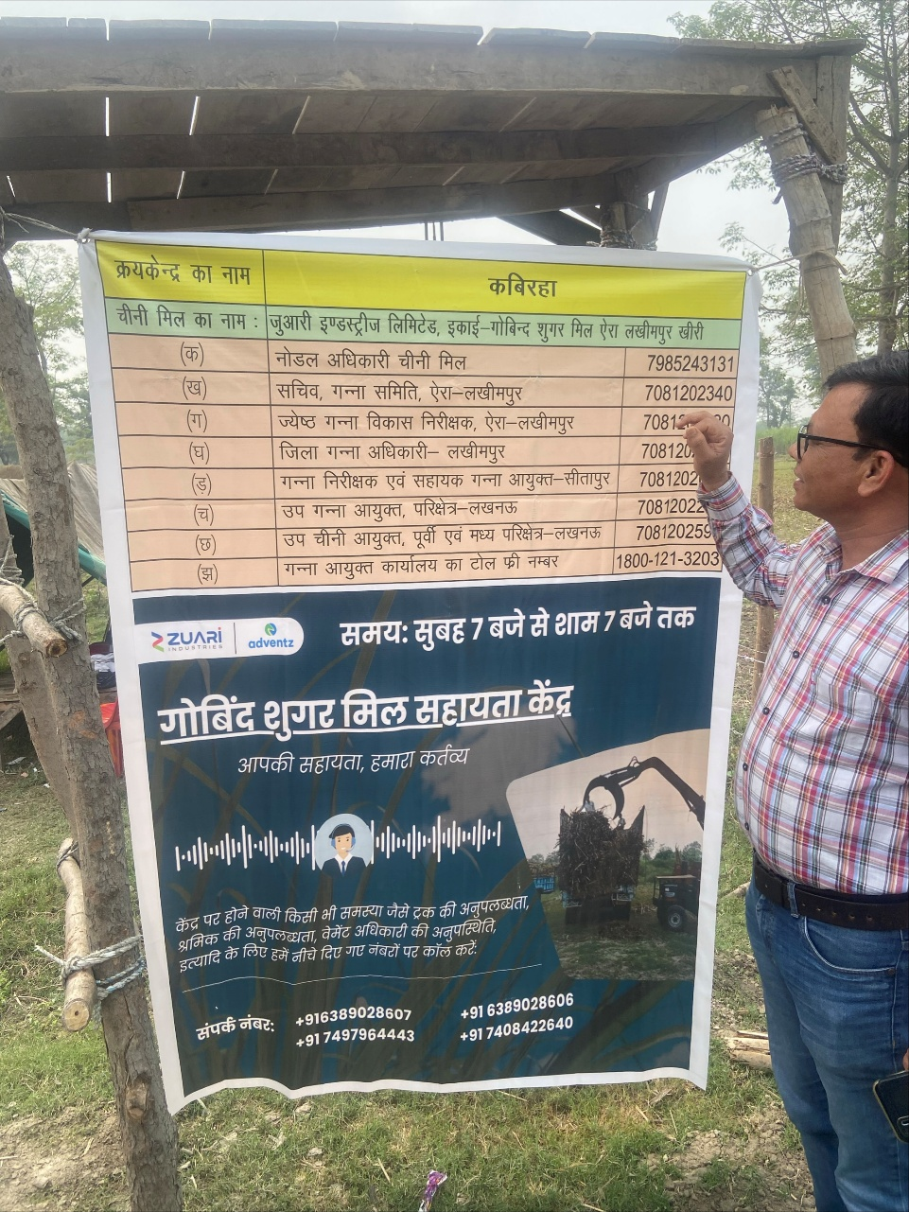
Call Center Update
Implemented call centre in cane office premises
Banners at all 107 centres displayed
S. No | Issue | Centre | Action taken | Status
1. | Cane Unloading | Dhorara II | Same day resolution | Solved

Slide 24
KOLHU AND CRUSHERS
Particulars | Total (No’s) | Rate/ Qtl. (Rs.) | Running (No’s) |  | Crushing (Qtls.) |  | Recovery (%)
 |  |  | This week | To Date (01.11.25) | This week | To Date (01.11.25)
Kolhu | 192 | 290-310 | 167 | 187 | 65450 | 86625 | 9.50%
Crushers | 14 | NA | 0 | 0 | 0 | 0 | NA

Slide 25
Comparative Payment Figures of Neighboring Mills (As on 01.01.2025)
Name of Factory | Date of Start | Payment Up to | Remarks
Aira | 26.10.2024 | Nil
Ajbapur | 31.10.2024 | Nil
Kumbhi | 31.10.2024 | Nil
Gularia | 01.11.2024 | Nil
Belrayan | 26.11.2024 | Nil | Tentative
Gola | 09.11.2024 | Nil | Tentative
Pallia | 21.11.2024 | Nil | Tentative
Khambharkhera | 08.11.2024 | Nil | Tentative

Slide 26
Other ongoing activities of the Department

Slide 27
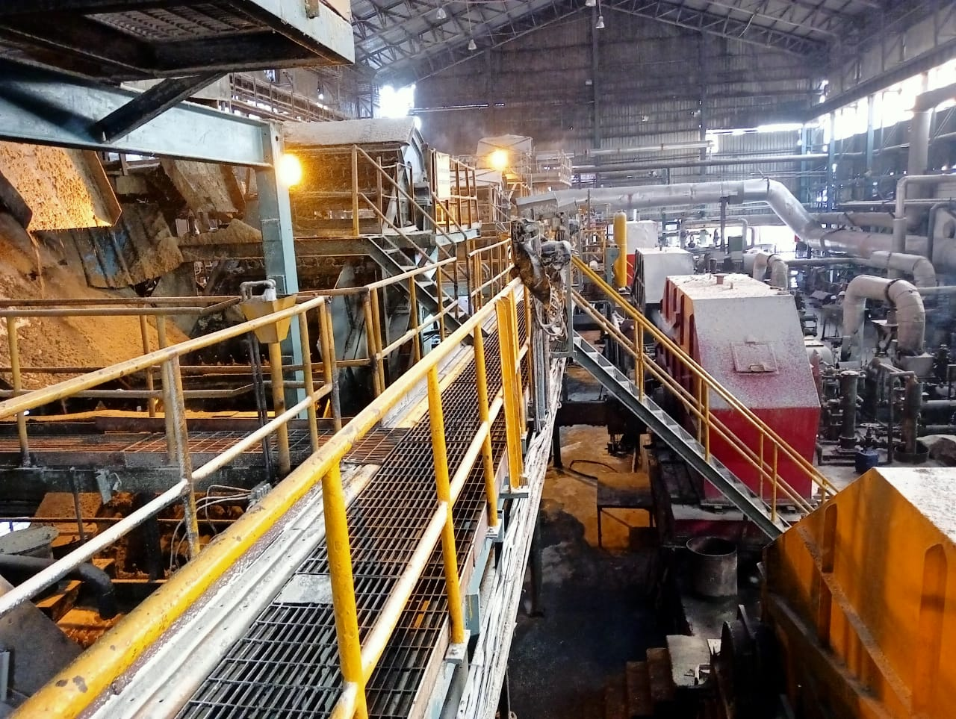
ENGINEERING

Slide 28
Weekly Performance Snapshot - Engineering
S.No. | Capacity Utilization | Target 2025-26 | Current Week | Last Week | Till Date
1 | Cane Crushed (LQ) (192 Days) | 179.00 | 4.254 | - | 4.254
2 | Hours Utilized (%) | 99.17 | 98.68 | - | 98.68
3 | Downtime (Hrs.) | 72.00 | 1.54 | - | 1.54
4 | Planned Stoppage (Hrs.) | 48.00 | 0.0 | - | 0
5 | Forced Shutdown (Hrs.) | 24.00 | 1.30 | - | 1.54
6 | Capacity Utilization in Uptime @ 1 LQ / Day Base (%) | 94.71 | 71.85 | - | 71.85
7 | Capacity Utilization incl. Stoppage (%) | 93.22 | 70.90 | - | 70.90
 | Quality
1 | Pol % Bagasse | 1.65 - 1.70 | 1.96 | - | 1.96
2 | Moisture % Bagasse | 49 - 49.5 | 50.52 | - | 50.52
 | Consumption
1 | Steam Consumption (KG/Qtl Cane) | 5.0-6.0 | 4.90 | - | 4.90
2 | Power Consumption (KW/T Cane) | 31.5 - 32 | 32.61 | - | 32.61
3 | Lubricant Consumption (Kg/100 Qtl Cane) | 0.04 | 0.108 | - | 0.108
28

Slide 29
Monthly figure
Plant Performance in Season 25-26
Sr No | Particulars | Unit | Season 25-26
 |  |  | Target | Achieved (Till Date )
1 | Total Cane Crushed | Qtls | 17900000 | 425400
2 | Date of Start | Date | 20/10/2025 | 26/10/2025
3 | Date of Finish | Date | 23/04/2026 | -
4 | Gross Season Days | Nos | 192 | 6
5 | Crushing rate Including Stoppage | Qtls | 93229 | 70,900
6 | Crushing rate Excluding stoppage | Qtls | 94709 | 71848
7 | Capacity Utilization | % | 94.71 | 71.85
8 | Total Stoppage Hours | Hrs. | 72.00 | 1.54
9 | Planned Shutdown | Hrs. | 48.00 | 0.0
10 | Forced Shutdown | Hrs. | 24:00 | 1.30
11 | Preparatory index | % | 90.0-91.0 | -
12 | Primary Extraction | % | 70.5-71.0 | -
13 | Mill Extraction ( ME) | % | 96 - 96.5 | 94.94
14 | Reduced mill Extraction (RME) | % | 96.4 - 96.80 | 95.16
15 | Bagasse % Cane | % | 29.00 | 28.22
16 | Pol % Bagasse | % | 1.65-1.70 | 1.96
17 | Moisture % Bagasse | % | 49.0 - 49.5 | 50.52
18 | Imbibition % Cane | % | 40 Max | 33.17
19 | Imbibition % Fibre | % | 290 - 295 | 255.15
20 | Dry Milling Factor | % | 71.25 | 71.39
21 | Grease & Lubricants Kg/100 Qtls Cane | % | 0.04 | 0.108
22 | Power Consumption ( KW/T Cane) | % | 31.5 - 32 | 32.61
23 | Steam Consumption(Kg/Q of Cane) | % | 5.0-6.0 | 4.90
29

Slide 30
General Observations
Physical / General Plant observations of the week
The plant Pujan on dated 24.05.25, Cane crushing Operation Started @ 5000 TCD on 25.10.25 at 7 PM with refinery house , DS house started 29.10.2025 at 10.54 AM. And the overall plant operations have been successfully established. All operational parameters are functioning within the specified limits for the week.
Particulars | Weekly |  | Till Date
 | SN. 25-26 | SN. 24-25 | SN. 25-26 | SN. 24-25
Hours Worked | 142.06 | 119.30 | 142.06 | 119.30
Hours Available | 144.00 | 120.00 | 144.00 | 120.00
Hours Utilized (%) | 98.68 | 99.58 | 98.68 | 99.58

Slide 31
Key Operational Parameter- Current Season Vs Last Season
Particulars | Weekly |  | To date
 | SN 25-26 | SN 24-25 | SN 25-26 | SN 24-25
Cane Crushed (In Qtls.) | 425400 | 238700 | 425400 | 238700
Rate of Crush | 70,900 | 47740 | 70,900 | 47740
Pol % Bagasse | 1.96 | 2.14 | 1.96 | 2.14
Loss in Bagasse % Cane | 0.55 | 0.66 | 0.55 | 0.66
Moisture % Bagasse | 50.52 | 52.37 | 50.52 | 52.37
Total Power Sugar kw/ Ton of cane | 32.61 | 39.18 | 32.61 | 39.18
Total Power MWH |  | 5.41 |  | 5.41
Lubricant Consumption. | 0.108 | 0.67 | 0.108 | 0.67

Slide 32
Stoppages, Actions & RCA for the Week
Date | Stoppages | Total Hrs. | Action | Root Cause Analysis | Repeated
29/10/2025 | IRC No-1 Tripped due to High Load | 0:01 | Reset & Started.
29/10/2025 | Mill Turbine No-1 Tripped due to Hunting, | 0:06 | Throttle valve opening adjusted & Started
30/10/2025 | IRC No-2 Bagasse wrapped in trough. | 0:20 | Bagasse Cleaned & Restated. | Loading fluctuation due to Rain.
30/10/2025 | Bagasse jamming in IRC No-1 | 0:43 | Bagasse Cleaned & Restated. | Loading fluctuation due to Rain.
30/10/2025 | Cane jamming at cane levelling pipe due to over cane feeding | 0:24 | Jamm Removed & Restarted. | Due to Cross cane feeding & Rain.
31/10/2025 | 3.0 MW turbine trip due to AVR malfunctioning of 3 MW New TG | 0:20 | Checked & Restarted
 | Total | 1:54

Slide 33
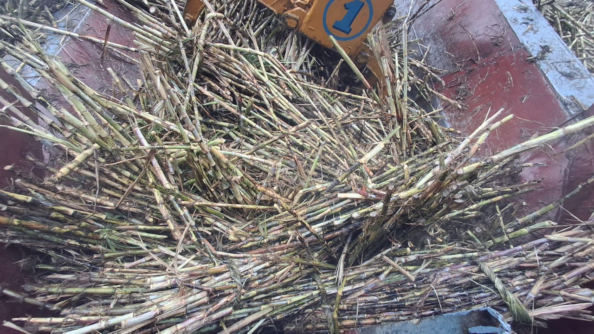
Cane jamming at cane levelling pipe due to over cane feeding

Slide 34
Milling Data
Crop Day | Date | Cane Crush in Qlts |  | Imbibition % Fiber |  | Maceration % Cane |  | Bag Pol |  | Bag Moisture |  | Power kw / T Cane |  | Lub Cons % Today | Stoppage |  | Stoppage Details
 |  | On date | To date | On date | To date | On date | To date | On date | To date | On date | To date | On date | To date |  | On date | To date
 | Target | 94709 | 17900000 | 290-295 |  | 40% Max |  | 1.65-1.70 |  | 49.00-49.5 |  | 31.50-32.00 |  | 0.04 | 72-0
1 | 26/10/2025 | 48000 | 48000 | 295.08 | 295.08 | 35 | 35 | 2.05 | 2.05 | 53.17 | 53.17 | 44.79 | 44.79 | 0.17 | 0
2 | 27/10/2025 | 504000 | 98400 | 244.40 | 267.99 | 31.75 | 33.33 | 2.02 | 2.03 | 52.33 | 52.75 | 39.09 | 44.87 | 0.08 | 0
3 | 28/10/2025 | 52500 | 150900 | 247.56 | 260.51 | 33.09 | 33.25 | 2.03 | 2.03 | 51.50 | 52.33 | 36.08 | 39.85 | 0.07 | 0
4 | 29/10/2025 | 90000 | 240900 | 243.62 | 254.07 | 32.44 | 32.95 | 2.02 | 2.03 | 51.08 | 51.08 | 27.35 | 35.18 | 0.040 | 0:07 |  | IRC No-1 Tripped due to High Load & Mill Turbine No-1 Tripped due to Hunting, Throttle valve opening tuned
5 | 30/10/2025 | 89500 | 330400 | 253.90 | 254.01 | 34.27 | 33.31 | 1.88 | 1.99 | 50.33 | 50.68 | 29.08 | 33.52 | 0.160 | 1:27
5 | 30/10/2025 | 89500 | 330400 | 253.90 | 254.01 | 34.27 | 33.31 | 1.88 | 1.99 | 50.33 | 50.68 | 29.08 | 33.52 | 0.160 | 1:27 |  | IRC No-2 Bagasse wrapped in trough, Bagasse jamming in IRC No-1 &Cane jamming at cane levelling pipe due to over cane feeding
6 | 31/10/2025 | 95000 | 425400 | 259.37 | 255.15 | 32.72 | 33.17 | 1.86 | 1.96 | 50.25 | 50.52 | 29.17 | 32.61 | 0.13 | 0:20 |  | 3.0MW turbine trip due to AVR malfunctioning of 3MW New TG

Slide 35
Vibration & Motor Power Data for Shredder Rotor
Crop Day | Date | Crush |  | Shredder Vibration & Bearing Temp ( LHS ) -1 |  |  |  |  | Shredder Vibration & Bearing Temp (RHS)-2
 |  | On date | To date | Motor LHS Power | Brg Temp (Avg) | V (Avg) | H (Avg) | A (Avg) | Motor RHS Power | Brg Temp (Avg) | V (Avg) | H (Avg) | A (Avg)
1 | 26/10/2025 | 48000 | 48000 | 29.11 | 51.05 | 0.74 | 0.75 | 1.39 | 27.70 | 52.16 | 0.64 | 0.52 | 1.31
2 | 27/10/2025 | 50400 | 98400 | 43.10 | 57.56 | 1.18 | 0.88 | 2.32 | 40.75 | 54.24 | 1.06 | 0.59 | 2.40
3 | 28/10/2025 | 52500 | 150900 | 46.50 | 56.17 | 1.13 | 0.85 | 2.02 | 43.28 | 57.03 | 0.89 | 0.61 | 2.21
4 | 29/10/2025 | 90000 | 240900 | 68.74 | 57.43 | 1.39 | 0.97 | 2.91 | 65.61 | 60.44 | 1.32 | 0.75 | 2.91
5 | 30/10/2025 | 89500 | 330400 | 70.97 | 58.72 | 1.53 | 1.14 | 3.95 | 68.56 | 59.81 | 1.28 | 0.84 | 3.22
6 | 31/10/2025 | 95000 | 425400 | 77.95 | 59.54 | 1.55 | 1.16 | 4.46 | 74.96 | 60.31 | 1.13 | 0.79 | 3.16

Slide 36
Draft Planned Schedule Cleaning for plant Season 25-26
SL | Date |  | No of days | C Rate / Days | Total Crush | Crush / Cleaning | Total Crushing | Remark
1 | 25/10/2025 | 31/10/2025 | 7 | 50000 | 350000
2 | 01/11/2025 | 20/11/2025 | 20 | 103500 | 2070000 | 2420000 | 2420000
3 | 21/11/2025 | 21/11/2025 | 1 | 75000 | 75000 |  |  | Schedule Cleaning-6 Hrs (Tips Reversal)
4 | 22/11/2025 | 30/11/2025 | 9 | 104000 | 936000
5 | 01/12/2025 | 17/12/2025 | 17 | 104000 | 1768000 | 2779000 | 5199000
6 | 18/12/2025 | 18/12/2025 | 1 | 70000 | 70000 |  |  | Schedule Cleaning-8 Hrs (Tips Replacement)
7 | 19/12/2025 | 31/12/2025 | 13 | 104000 | 1352000
8 | 01/01/2026 | 13/01/2026 | 13 | 104000 | 1352000 | 2774000 | 7973000
9 | 14/01/2026 | 14/01/2026 | 1 | 60000 | 60000 |  |  | Schedule Cleaning-10 Hrs (Hammer with tips Replacement)
10 | 15/01/2026 | 31/01/2026 | 17 | 104000 | 1768000
11 | 01/02/2026 | 10/02/2026 | 10 | 104000 | 1040000 | 2868000 | 10841000
12 | 11/02/2026 | 11/02/2026 | 1 | 75000 | 75000 |  |  | Schedule Cleaning-6 Hrs (Tips Reversal)
13 | 12/02/2026 | 28/02/2026 | 17 | 104000 | 1768000
14 | 01/03/2026 | 03/03/2026 | 3 | 103500 | 310500 | 2153500 | 12994500
15 | 04/03/2026 | 05/03/2026 | 2 | 40000 | 80000 |  |  | Holi (Tip Replacement)
16 | 06/03/2026 | 31/03/2026 | 26 | 102000 | 2652000 | 2732000 | 15726500 | 157 L Qtls Cane will Be Crushed
17 | 01/04/2026 | 01/04/2026 | 1 | 80000 | 80000 |  |  | Schedule Cleaning-6 Hrs (Tip Reversal)
18 | 02/04/2026 | 23/04/2026 | 22 | 85000 | 1870000
19 | 24/04/2026 | 30/04/2026 | 7 | 50000 | 350000 | 2300000 | 18026500 | End of Season ( Total Time- 48 Hrs)
 |  | Total | 188 |  | 18026500 |  | 18026500 | Total Approx Cane Crush.
 | 20/10/2025 | 29/04/2026 | 192 | Average | 93229.17 |  | 17900000 | Target Cane Crush

Slide 37
MILL-Capex Status 25-26
S.NO | Project Name | Objective of Project | Budget | PO |  |  |  | Status | Remarks
A | Mills |  |  | No | Date | Vendor | Delivery Date | Date
1 | Mill Roller | New Mill Roller Shaft for 42" x 84" size Mill Complete with shell. | 32.90 | 25001 / 250745,255350/25.07.25 | 07.04.2025 | M/s Jassal Engrs Ludhiana | 20.07.2025/ 20.08.2025 | Drawing sent for machining Work | Spare Roller ( expected by end of Nov 25)
2 | Cane Unloaders | Conversion of Mechanical Hoist to Hydraulic motion of Cane Unloader 1st & 6th. | 24.25 | Deferred for This Year
3 | Rotary Screen | Refurbishment of Rotary Screen No 2 | 23.50 | 250427 | 05.06.2025 | SUVIRON EQUIPMENT | 31.07.2025 | Received on 29.08.2025 | Installed & In Operation.

Slide 38
Boiling House-Capex Status 25-26
S.NO | Project Name | Objective of Project | Budget | PO |  |  |  | Status | Remarks
B | Boiling House
1 | 36 ft Clarifier | Worn out shell replacement | 21.25 | Materail PO-250597 Service PO No-255205 | 23.06.2025 28.06.2025 | Prakash Enterprises Kanur Cont No-9935558380 Rajat Engineering Contact No- | 30.05.2025 | Completed | Delayed in completion due to MS plate received on 23.07.2025
2 | B Vertical Crystallizer drive in D.S. House | Existing Damage Drive Replacement | 13.30 | 250868 | 22.07.2025 | Kavistu Transmission Ltd. | 30.08.2025 | Drive Received on 101.10 & fitted at one shell
3 | C Vertical Crystallizer D.S. House | Worn-out Coil Replacement | 16.15 | Serive Order No-255206 Bend PO-250800 | 28.06.2025 / 16/07/2025 | Sri Ram Contractor 9793567027 | 05.06.2025 | Coil replaced. | Delayed due to Delay receipt of MS Bend

Slide 39
Boiling House-Capex Status 25-26
S.NO | Project Name | Objective of Project | Budget | PO |  |  |  | Status | Remarks
 |  |  |  | No | Date | Vendor | Delivery Date | Date
4 | 4 Deck type Sugar grader with two no's 6 deck type I.C. Grader in D.S .house | Aged Grader Replacement | 37.75 | Hold due to Long Delivery
5 | Spiral chute of JT-2 into roller chute | facing sugar bags torn off problem due to friction, and during cold days to much moister deposit on spiral chute and giving problem to sliding of sugar bags | 15.20 | Hold as Hot blower provision is being done
6 | Pan no-7 &11 both discharge valve | Installation of pneumatic valve | 6.25 | 250737 | 09.07.2025 | Puri Industries | 15.08.2025 | Installed | Received on 05.09.2025 & Installed

Slide 40
Boiling House-Capex Status 25-26
S.NO | Project Name | Objective of Project | Budget | PO |  |  |  | Status | Remarks
 |  |  |  | No | Date | Vendor | Delivery Date | Date
8 | C Vertical Crystallizer coil in Raw and refinery House | Worn-out coil Replacement | 29.00 | Material PO -250343 Service Order -255256 | 22.05.2025 28.06.2028 | Medha Industrial Corporation THARAYIL Egg. | 15.06.2025 30.07.2025 | Replaced | 875 Received on 19.09.25
9 | R-1 and R-2 Molasses pump delivery pipeline | Worn out Pipeline replacement | 16.15 | 250761 / 250555/250554 / 250654 | 11.07.25/20.06.25/20.06.25/20.06.25 | Shah Exp/Mars/ Darbari Lal /Steel Sales | 20.08.25/10.07.25/20.07.25 | Work Completed. | Pipeline received on 05.09.2025, Completed
10 | A-1 Massecuite Pump with Zero leak PSP Pump | Both pump casing is worn-out | 6.60 | 250666 | 02.07.2025 | PSP Pump | 20.08.2025 | New Pumps fitted | Received on 18.09 . One fitted, 2nd U/P
11 | Slate type sugar bag stacker with Belt Type stacker | Sugar bags get stuck between slates, causing this the bags torn off. | 5.25 | PO Done |  |  |  | Material awaited

Slide 41
Electrical -Capex Status 25-26
S.NO | Project Name | Objective of Project | Budget | PO |  |  |  | Status | Remarks
C | Electricals |  |  | No | Date | Vendor | Delivery Date | Date
2 | New 3.0 MW TG | Old Existing Generator protection relay to be replaced with new micom P343 relay | 4.43 | 3 MW Load sharing- Yes |  |  |  | Received | Installation done, commissioning done. & Running Position
3 | New 3.0 MW TG | New 3.0 MW Incomer panel complete with (4000 ampx2) ACB Make- L&T to be replaced with new panel including retrofitting in existing PCC | 18.90 |  |  |  |  | Received
4 | Power House PCC | Two No existing outgoing breaker -1250 amp & 1000 amp need to be replaced & retrofitting with 1600-amp new breaker for 70 Ton boiler in Powerhouse PCC | 6.10 | 250778 | 12/07/2025 | Rhythm Automation | 27/07/2025 | Received | Work Done & running Position
6 | Cane Unloader No-1 ,4 & 5 | Cane Unloader No-1 ,4 &5 cabling to be done thru cable trolly with channel in place of sling rope wire | 7.70 | 250744 | 10/07/2025 | SHYAM ENGG. | 30/07/2025 | Received | Work Done & Running position

Slide 42
Electrical -Capex Status 25-26
S.NO | Project Name | Objective of Project | Budget | PO |  |  |  | Status | Remarks
 |  |  |  | No | Date | Vendor | Delivery Date | Date
7 | Main Cane Carrier drive VFD ( 110 KW) | Main cane carrier VFD need to be replaced with new ACS 580 due to Old drive ACS850-04-387A-5+J400 has been obsoleted by ABB and few spares not avail in market | 5.58 | 250746 | 10/07/2025 | ALPHA CONTROL | 30/07/2025 | Received | Work Done
8 | Feeder Drum drive VFD ( 75 KW) | Feeder Drum VFD need to be replaced with new ACS 580 due to Old drive ACS850-04-225A-5+J400 has been obsoleted by ABB and few spares not avail in market | 3.45 | 250746 | 10/07/2025 | ALPHA CONTROL | 30/07/2025 | Received | Work Done
9 | Shredder Belt conveyor drive VFD ( 37 KW) | Shredder Belt need to be replaced with new ACS 580 due to Old drive ACS850-04-144A-5+J400 has been obsoleted by ABB and few spares not avail in market | 2.75 | 250746 | 10/07/2025 | ALPHA CONTROL | 30/07/2025 | Received | Work Done
10 | Existing Batch Machine ( DS House) | Renovation of Existing Batch M/C VFD panel room of DS house with ACP & puf panels & roofing with strong structure sheet & False ceiling requirement & strengthening for AC cooling. (Size -29L x 13W x 15H feet for main roof & 10.5H feet for false ceiling) | 7.30 |  |  |  |  | Received | Work Under Progress. Cabin work done- only false ceiling to be done

Slide 43
Electrical -Capex Status 25-26
S.NO | Project Name | Objective of Project | Budget | PO |  |  |  | Status | Remarks
 |  |  |  | No | Date | Vendor | Delivery Date | Date
11 | D S House Breaker (MCC-1) | 1600 Amp ABB breaker with cradle to be replaced with new due to old breaker heated of Injection MCC-1 & FFE MCC in DS House | 6.05 | 250741 | 10.07.25 | Riythm Automation | 20.09.25 | Received | Work Done
13 | D S House Breaker Panel | Three No breaker panel of 1600 amp requirement at MCC-1 GD floor due to open type two No breaker are used for making power arrangement to Injection MCC-3 & Distillery LT power during off season & Now we need to connect these from Transformer bus duct thru 10 No cables of 25 meter for load adjustment of one ton & 1750 KG batch M/C on transformer | 11.20 | 250741 | 10.07.25 | Riythm Automation | 20.09.25 | Received | Work Done
14 | 1750 Batch M/C VFD panel | New VFD panel ACS 880 or latest requirement for 1750 KG batch type Machine of raw house to replace the old ACS 800 VFD panel due to obsoleted in market. | 22.70 |  |  |  |  | Received | Work Done
15 | 1750 Batch M/C VFD panel | New VFD panel ACS 880 or latest requirement for 1750 KG batch type Machine of refinery house to replace the old ACS 800 VFD panel due to obsoleted in market | 22.70 |  |  |  |  | Received | Work Done

Slide 44
Electrical -Capex Status 25-26
S.NO | Project Name | Objective of Project | Budget | PO |  |  |  | Status | Remarks
 |  |  |  | No | Date | Vendor | Delivery Date | Date
16 | Syrup Extraction Pump VFD | New VFD requirement for existing Syrup extraction PP 1 &2 due to old existing VFD ACS 550-01-059A-04 obsoleted. | 1.85 | 250760 | 11/07/2025 | Rhythm Automation | 20/07/2025 | Received | Work Done
19 | ETP MCC panel | Existing not have any MCC panel and starters are kept at different location which is not in proper electrical manner & control | 9.06 | Hold for This Year, will be done with ETP Upgradation
20 | MCC 1 VFD Panel | Existing split AC are 10-year-old & not working properly | 2.60 | 250758 | 10.07.25 | JMD ENTERPRISES | 30.07.25 | Received | Work Done
21 | Powerhouse PCC Cooling System | To prevent bagasse dust inside the PCC & overcome to temp rising problems during Feb to April | 23.75 | Will be done based on requirement |  |  |  |  | Hold

Slide 45
Instrument -Capex Status 25-26
S.NO | Project Name | Objective of Project | Budget | PO |  |  |  | Status | Remarks
D | Instrument |  |  | No | Date | Vendor | Delivery Date | Date
1 | ABB PM583 panel | Raw continuous pan ABB PM583 panel builder 600 system upgrade windows 7 to windows 10 or 11 | 2.12 | Will be done with complete upgradation
2 | Allen-Bradley RS logix 500 system | Refinery Allen-Bradley RS Logix 500 system upgrade windows 7 to windows 10 or 11
3 | Upgrade windows | Upgrade windows 7 to windows 10 or 11 for SEDL system
6 | Online Monitoring in DCS | All mill bearing temperature & critical lub-oil pressure to be taken in DCS | 3.35 | 250923 / 251118 | 25/7/2025 / 11/8/2025 | M/s Pioneer Automation / Rotex Control | 30/9/2025 / 5/9/2025 |  | Work Done
7 | Brix sensor | Raw B & C cont. pan brix sensor absolute by manufacture not available in market | 9.00 | 250698 | 05.07.25 | INSTRUMENTS & SYSTEMS | 20.08.25 | Received | Work Done
8 | Mass flow meter | Mass flow meter size 6-inch application sugar cane juice flow range 350 TPH | 22.00 | 250862 | 22/07/2025 | M/s Pioneer Automation | 25/09/2025 | Received | Work Done
11 | LT & Control Valve | B Havey holding tank level control | 1.20 |  |  |  |  | Hold
12 | Auto Batch Weighing Scale | Auto weighing scale batch Type for Molasses C Havey | 7.70 |  |  |  |  | Hold

Slide 46
CRITICAL SPARES: Capex Status 25-26
S.NO | Project Name | Objective of Project | Budget | PO |  |  |  | Status | Remarks
A | Mill |  |  | No | Date | Vendor | Delivery Date | Date
1 | Planetary Drive | Procurement of spare Planetary Gear Box for Shredder Elevator & IRC No 1 | 18.53 | 250713 | 08.07.25 | FRONTLINE TECHNOCARTS (P) LTD. | 10.10.25 | Material awaited | Expected by 10.11.2025
2 | Shafts | Procurement of spare Head & Tail Shaft Assembly (with sprockets) for Shredder Elevator & IRC No 1 | 13.70 | 250669 Shaft & 250599 Sprocket | 03.07.25 & 24.06.2025 Sprocket | Bharat Forge & M/s Premchand | 30.09.25 Shaft & Sprocket 31.08.25 | Material awaited | 2 shaft out of 3 Nos received for machining PO -255482/06.09.25
3 | Shafts | Procurement of spare Head & Tail Shaft Assembly (with sprockets) for IRC 2nd to 4th | 11.65 | 250669 Shaft & 250599 Sprocket | 03.07.25 & 24.06.2025 Sprocket | Bharat Forge & M/s Premchand | 30.09.25 Shaft & Sprocket 31.08.25 | Material awaited | 2 Nos Shaft received for machining PO -255482/06.09.25
4 | Gear | CAST STEEL DOUBLE HELICAL GEAR86 TEETH X 25 MODULE -2 Nos |  | P/NR/F/242841 | 21/02/2025 | SRINATHJI ISPAT LTD | 27/08/25 | One No Received & fitted | One No awaited
B | Boiling House
4 | Drives | 36 ft Clarifier Drive worm and worm wheel | 3.60 | 15165 | 09.07.25 | KAVITA ENGINEERING WORKS | 15.08.25 | Drive Received | New Drive received 16.08.2025
8 | Drives | Raw Sugar and Refinery Sugar Pugmill drive gear box- spares for 03 | 6.15 | Y | Y | Y |  | Material in transit | PI Received 08.10.25
9 | Drives | Raw Sugar Mingler drive gear box- spares for 03 | 5.15 | Y | Y | Y |  | Payment done | PI Received 08.10.25

Slide 47
CRITICAL SPARES: Capex Status 25-26
S.NO | Project Name | Objective of Project | Budget | PO |  |  |  | Status | Remarks
A | Mill |  |  | No | Date | Vendor | Delivery Date | Date
C | Electrical
1 | Relay Mecom P-343 | 3.MW TG set | 4.43 | Y | Y | Y |  |  | spare material is be indent after installation of Load sharing panel
2 | Breaker 4000 A | Breaker E-Max2 ,4000 A for old TG incomer against two no breaker | 5.00 | PR Done, Comparative done |  |  |  |  | PO Done ( Spare)
3 | Breaker 4000 A | Spare breaker E-Max ,4000 A for D S PCC incomer form powerhouse | 5.00 |  |  |  |  | Received | Work Done & running Position
4 | Motor 37 KW,1470 RPM, | Motor for Cane unloaders | 1.65 | 250735 | 09/07/2025 | Ashirwad | 09.07.25 | Received | Critical Spare
5 | Motor 75 KW | Motor for Feeder Drum | 3.00 | 250736 | 09/07/2025 | ALPHA CONTROL INSTRUMENTS | 10.09.25 | Received | Critical Spare
6 | Motor 55 K | Motor for IRC No-1 | 2.40 | 250801 | 16.07.25 | Ashirwad | 25.09.25 | Received | Critical Spare

Slide 48
CRITICAL SPARES: Capex Status 25-26
S.NO | Project Name | Objective of Project |  | Budget | PO |  |  |  | Status | Remarks
A | Mill |  |  |  | No | Date | Vendor | Delivery Date | Date
D | Instrumentation
1 | 1769-L36ERM 1769-L36 ERM compact Logix 5370 L3 controllers | MCS PLC Controller | MCS PLC Controller | 5.35 | 250742 | 10.07.25 | SI Energy Ventures | 15.08.25 | Received | Critical Spare
2 | Embedded controller | SEDL PLC Controler ( Colling Condensor) | SEDL PLC Controller ( Colling Condenser) | 2.72 | 250650 | 28.06.2025 | SEDL | 25.07.2025 | Received | Fitted at Position & Running Position
3 | Controller-F701S | Sugar Weighing Machine | Sugar Weighing Machine | 1.25 | 250697 | 05.07.25 | HI Tech Engineers | 05.07.25 | Received
4 | Controller for ABB PM-583 CPU AC500 | B & C Continiouse Pan PLC | B & C Continuous Pan PLC | 1.85 |  |  |  |  | Hold | Will be done with DCS
5 | Molasses weighing scale model I 410 batch controller | Molasses Weighing Scale | Molasses Weighing Scale | 1.50 | 250675 | 04.07.25 | PRECIA MOLEN INDIA PVT. LTD | 25.08.25 | Received | Critical Spare
6 | Communication module model no-CI854a | DSC Communication module model | DSC Communication module model | 2.90 | 251139 | 12/08/2025 | Alpha Control | 15/10/2025 | Received | Critical Spare
7 | Cluster module base plate | DCS Cluster Modlule | DCS Cluster Module | 1.00 | 250872 | 22/07/2025 | ALPHA CONTROL | 15/08/2025 | Received | Critical Spare
8 | Woodward governor controller 505 | 3MW Governor | 3MW Governor | 16.20 | 251302 | 26/08/2025 | Powerstar Engg. | 08/10/2025 | Received | Critical Spare
9 | Digitalization | Misc (New Initative/ upgradation & Unseen) | Misc (New Imitative/ upgradation & Unseen) | 16.95

Slide 49
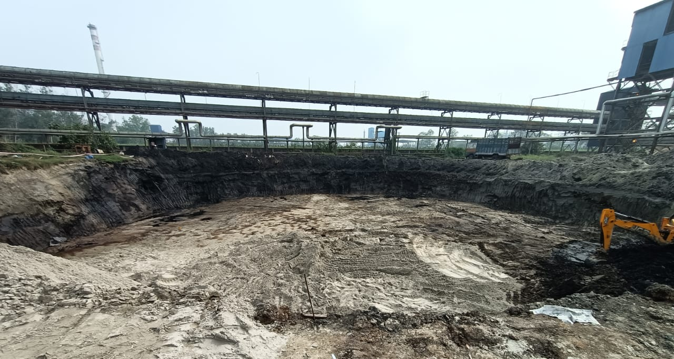
New Molasses Tank Foundation digging work Under progress
Capex Under Progress

Slide 50
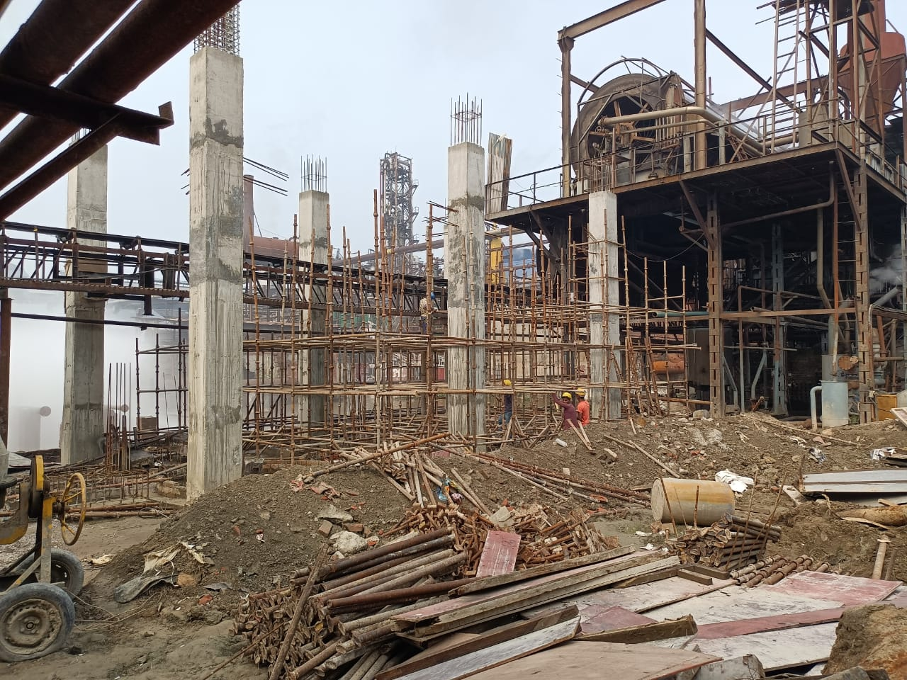
Mud removing System- Scaffolding fixing work U/P for Top slab beam & slab Level.
Capex Under Progress

Slide 51
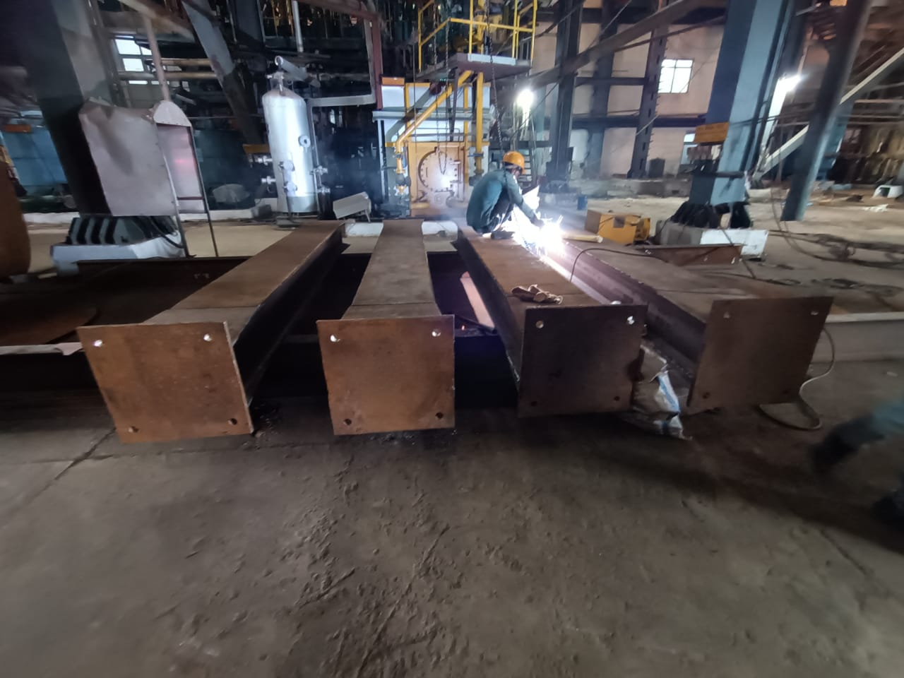
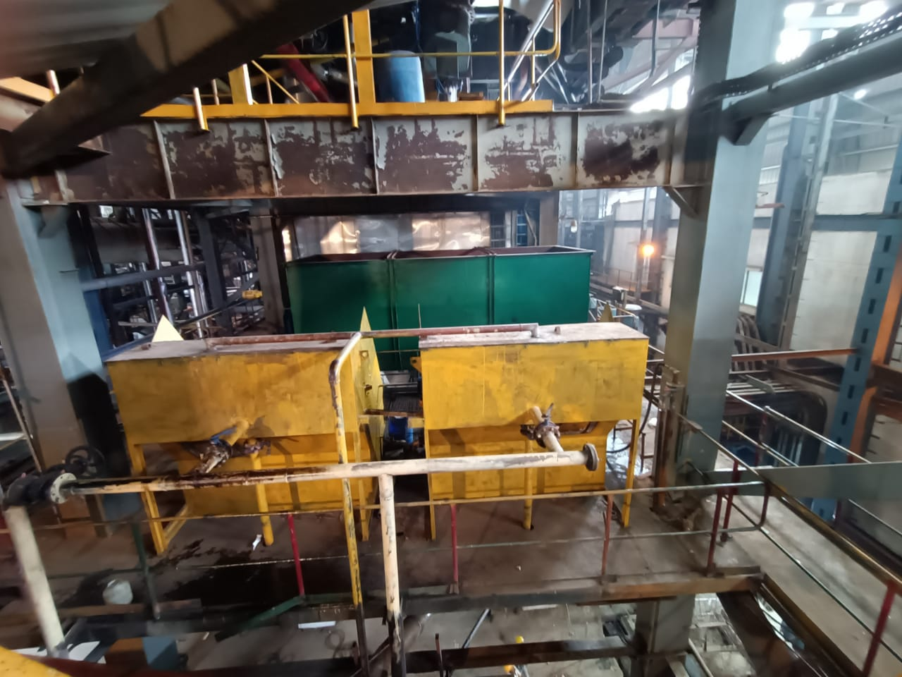
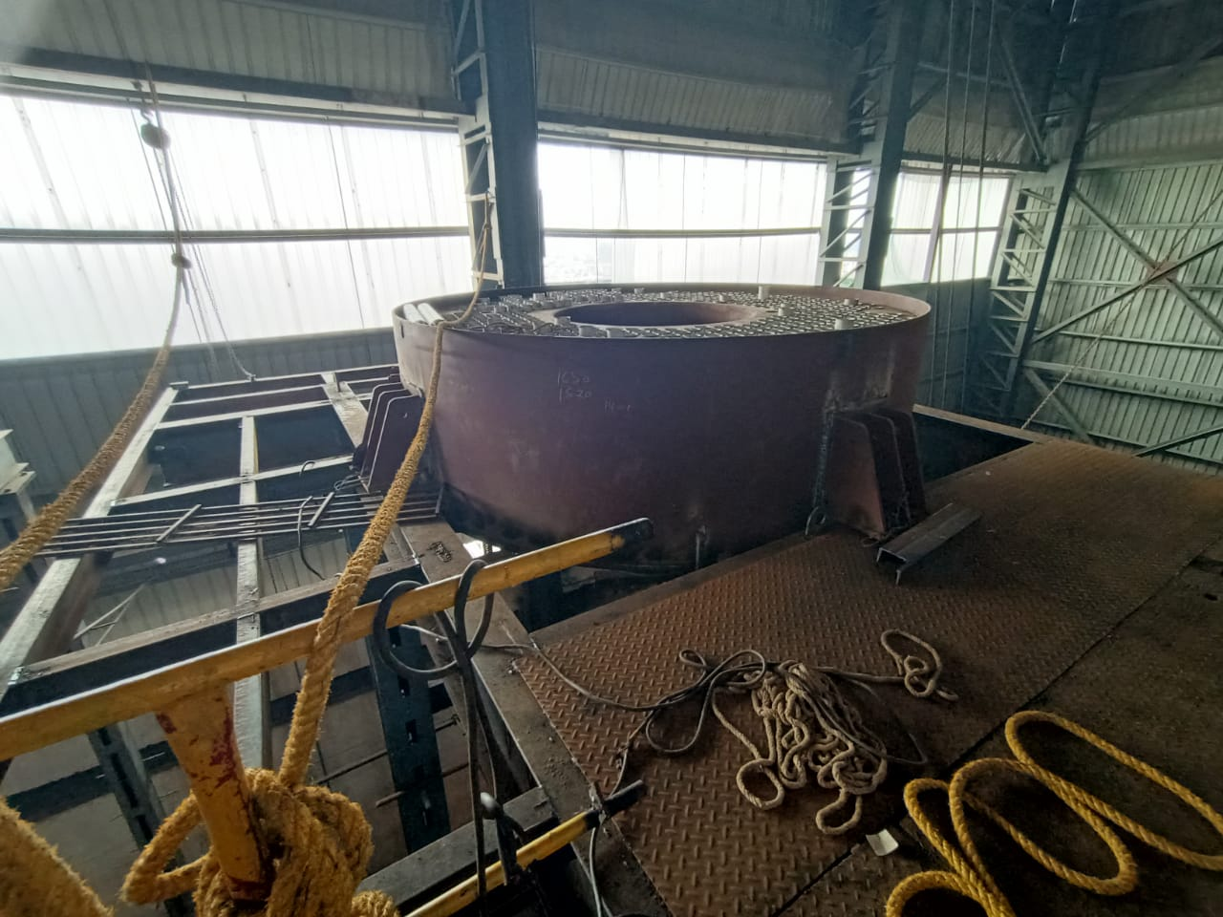
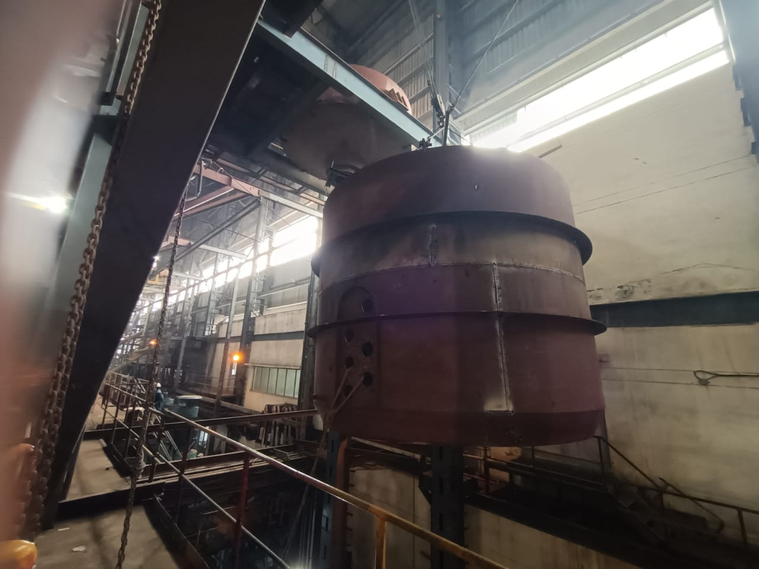
Pan Calandria placed at position & Pan Body Lifting work U/P
Capex Under Progress
R3 Massecuite Boiling work under Progress
Crystallizer Placed at Position
1750 C/F Mach Column Fabrication work done & welding U/P

Slide 52

PRODUCTION

Slide 53
General Observation
Crushing started on 25th October 2025 .
Both houses is running on CH diversion .
DS House started on 29/10/2025.
R3 pan calandria and shell placed at the position .
Mud removal system civil work in progress.

Slide 54
Weekly Performance Snapshot - Production
No. | Capacity Utilization | Target | Current Week | Last Week | Till Date
1 | Sugar Production (LQ) | 14.24 | 0.12 |  | 0.12
2 | Sugar Bagging – RS (Qtl) | 859457 | 9640 |  | 9640
3 | Sugar Bagging – DS (Qtl) | 564643 | 2440 |  | 2440
 | Recovery
4 | Sugar Recovery BH – RS (%) | 10.20 | 9.00 |  | 9.00
5 | Sugar Recovery BH – DS (%) | 10.20 | 9.00 |  | 9.00
6 | C-Mol Recovery – RS (%) | 4.80
7 | C-Mol Recovery – DS (%) | 5.20
 | Quality
8 | C-Mol Purity – RS | < 33.00 | 32.14 |  | 32.14
9 | C-Mol Purity – DS | < 32.00 | 32.28 |  | 32.28
10 | Losses in Mol % Cane CH – RS | < 1.39 | 1.08 |  | 1.08
11 | Losses in Mol % Cane CH – DS | < 1.46 | 1.08 |  | 1.08
12 | Pol % Filter cake | < 2.00 | 2.21 |  | 2.21
 | Consumption
14 | Steam Consumption (Kg/Qtl Sugar) | 400 | 846 |  | 846
15 | Steam % Cane | <42 | 39.21 |  | 39.21
16 | Power Consumption (Units/Qtl Sugar) | 11 | 18.18 |  | 18.18
54

Slide 55
Weekly Sugar Production – DS House
Production Plan for Next Week
SKU | Quantity (Qtls) | % of Total
L | 0 | 0
M | 19073 | 90
S | 2119 | 10
Total | 21192 | 100

Slide 56
Weekly Sugar Production – RS House
Production Plan for Next Week
SKU | Quantity (Qtls) | % of Total
L | 3107 | 10
M | 21746 | 70
S | 4660 | 15
Pharma | 1553 | 5
Total | 31066 | 100
Icing | 100 | 3.32
Bura | 165 | 5.48
Sachet | 121 | 4.02
1kg pack | 825 | 27.40
5kg pack | 550 | 18.26
Superfine | 88 | 2.92
Brown 1kg | 163 | 5.40
Pharma | 1000 | 33.20
Total | 3012 | 100%

Slide 57
Sugar Production Quality
Sugar Quality | Season 2025-26 |  |  |  | Season 2024-25
 | Target | Current Week | Last Week | Till Date | Week | Till Date
Sugar Quality - DS
ICUMSA (L-sugar) | <110
ICUMSA (M-sugar)
ICUMSA (S-sugar)
Sugar Quality – RS
ICUMSA (L-sugar) | <30 | 36 |  | 36
ICUMSA (M-sugar) |  | 30 |  | 30
ICUMSA (S-sugar) |  | 30 |  | 30
Sugar Quality Pharma
ICUMSA (SS - Sugar) | <25
ICUMSA (20/80 - Sugar)
ICUMSA (30/80 - Sugar)

Slide 58
Monthly Performance Snapshot - Production
S.No. | Capacity Utilization | Target | Nov-25 | Nov.-24
1 | Sugar Production (LQ) | 14.24
2 | Sugar Bagging – RS (Qtl) | 859457
3 | Sugar Bagging – DS (Qtl) | 564643
 | Recovery
4 | Sugar Recovery – RS (%) | 11.1
5 | Sugar Recovery – DS (%) | 11.1
6 | C-Mol Recovery – RS (%) | 4.8
7 | C-Mol Recovery – DS (%) | 5.2
8 | B-Mol Recovery – RS (%) | 6.8
9 | B-Mol Recovery – DS (%) | 7.2
 | Quality
10 | C-Mol Purity – RS | <33.00
11 | C-Mol Purity – DS | <32.00
12 | B-Mol Purity – RS | <51.00
13 | B-Mol Purity – DS | <51.00
14 | Losses in Mol % Cane CH– RS | <1.39
15 | Losses in Mol % Cane CH – DS | <1.46
16 | Losses in Mol % Cane BH – RS | <3.00
17 | Losses in Mol % Cane BH – DS | <3.18
18 | Pol % Filter Cake | <2.00
 | Consumption
19 | Steam Consumption (Kg/Qtl Sugar) | 400
20 | Steam % Cane | 42
21 | Power Consumption (Units/Qtl Sugar) | 11

Slide 59
Steam Consumption Target Vs Actual
Steam consumption target Vs actual at different process
At Recovery % | Process option - 1 |  | Process option - 2 |  | Process option - 3
 | Both Process on C-heavy with 125 KLD Distillery on Syrup |  | Both process on B-heavy with 125 KLD Distillery on Syrup |  | Both process on B-heavy
 | Target | Actual till date | Target | Till date | Target | Weak actual | Actual Till date
10.50 | 42.00 | 39.21 | 40.51 |  | 41.00

Slide 60
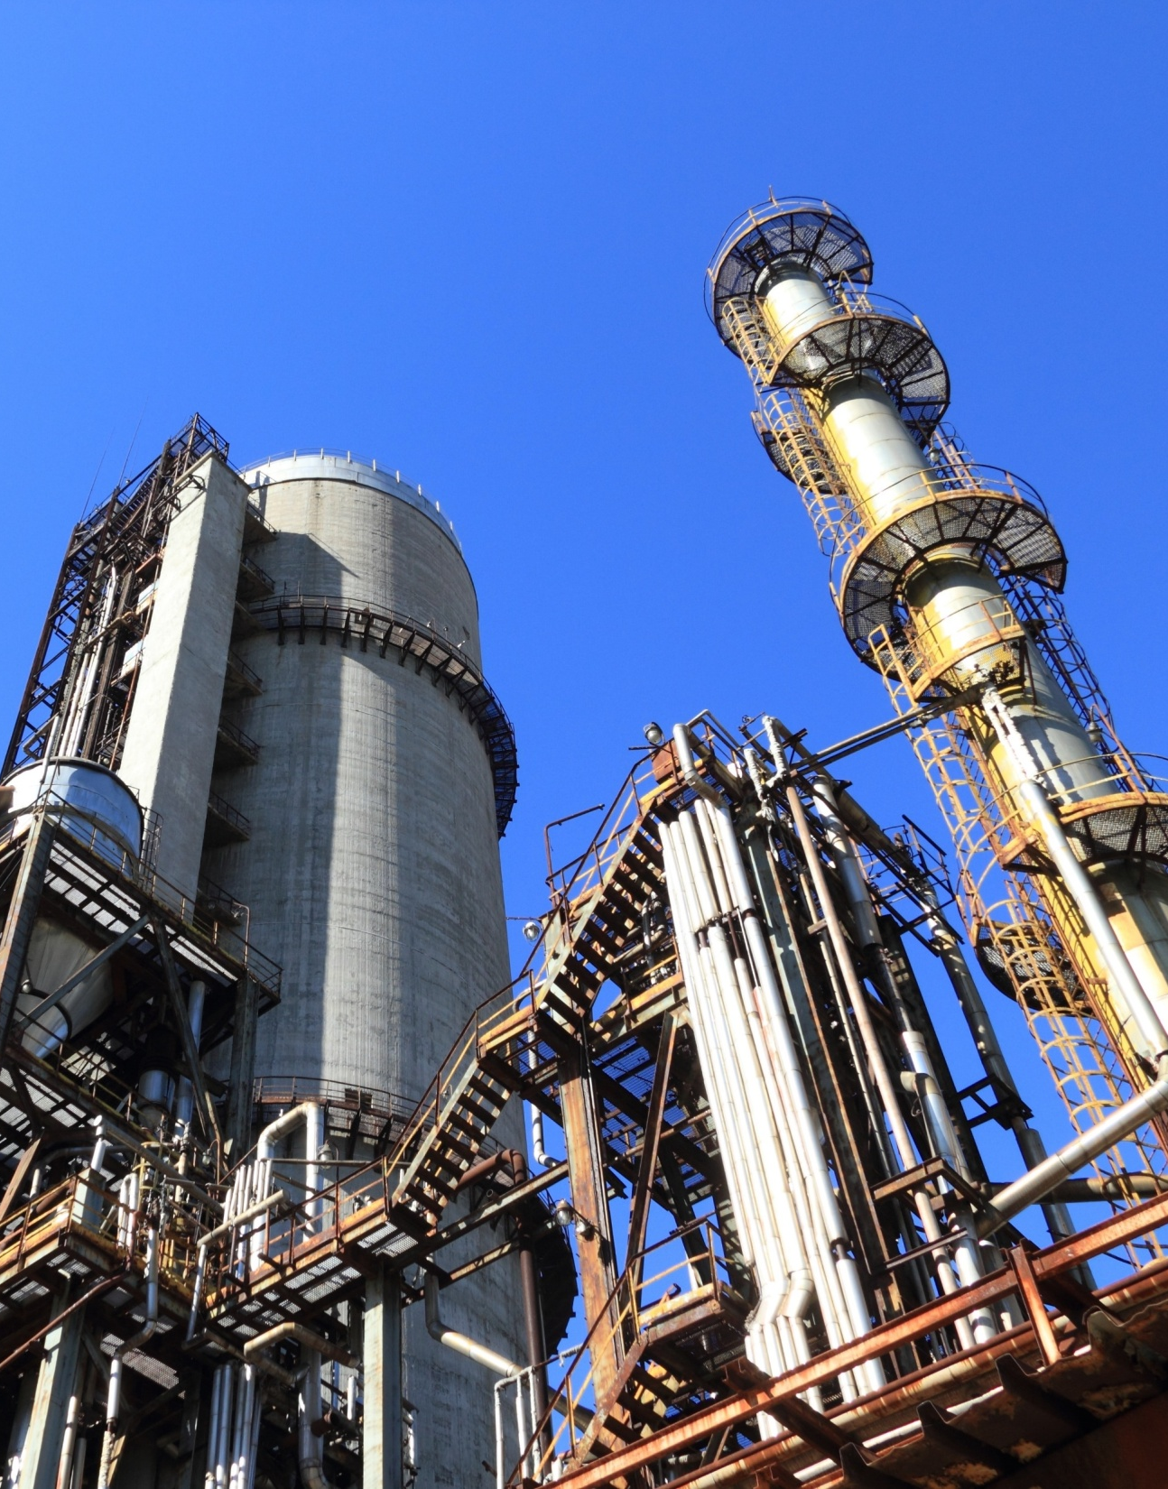
POWER PLANT

Slide 61
HIGHLIGHTS FOR THE WEEK
30.85 MW Power Plant – The 30.85 MW Co-gen Plant was started on 24/10/2025. All parameters of the 150 TPH Boiler and 30.85 MW Turbine were found within limits during full-load operation. Steam supply to the Fermentation Plant (Distillery) was provided from 26/10/2025 to 28/10/2025. Engineers from EKA Press Techno Services Pvt. Ltd. visited the plant for online safety valve setting, which was successfully completed for all three boilers. 70 TPH Boiler- The 70 TPH Boiler was started on 28/10/2025 as per the demand for steam and crushing requirements. 4.0 MW Distillery Power Plant- The 4.0 MW Distillery Co-gen Plant was started on 29/10/2025, and steam supply to the Distillery Plant commenced on 30/10/2025. A leakage was observed in the 35 TPH Boiler front water wall panel on 30/10/2025, which was attended and rectified the same day. Total stoppage time: 03 hours.

Slide 62
Weekly Performance Snapshot - Power
S.N | Generation & Export | Current Week | Last Week | Till Date
1 | Total Power Generation (LU) | 44.69 | 0 | 44.69
2 | Power Export (LU) | 29.80 | 0 | 29.80
3 | Power Export (%) | 66.68 | 0 | 66.68
 | Power Consumption (% of Gen.) | 33.32 | 0 | 33.32
4 | Sugar Plant Process (% of Gen. ) | 21.93 | 0 | 21.93
5 | Distillery Plant Process (% of Gen. ) | 1.46 | 0 | 1.46
6 | Aux Consumption (% of Gen.) | 9.93 | 0 | 9.93
62

Slide 63
Weekly Performance Snapshot – Power
 | Boiler Capacity Utilization | Target | Current Week | Last Week | Till Date (25-26) | Till Date (24-25)
10 | Capacity Utilization - 150 TPH | >144.0 | 151.7 | 0 | 151.7 | 72.3
11 | Capacity Utilization – 70 TPH | >64.0 | 51.0 | 0 | 51.0 | 46.7
12 | Capacity Utilization – 35 TPH | >33.0 | 28.4 | 0 | 28.4 | 26.6
 | Turbine Capacity Utilization
13 | PLF % – 30.85 MW | > 95.00 | 95.16 | 0 | 95.16 | 49.64
14 | PLF % – 3.0 MW (O) | > 90.00 | 73.61 | 0 | 73.61 | 92.99
15 | PLF % – 3.0 MW (N) | > 75.00 | 42.71 | 0 | 42.71 | 52.88
16 | PLF % – 4.0 MW | > 80.00 | 71.82 | 0 | 71.82 | 59.48
 | Efficiency
17 | Steam/Fuel Ratio – 150 TPH | ≥2.54 | 2.51 | -- | 2.51 | 2.16
18 | Steam/Fuel Ratio – 70 TPH | ≥2.19 | 2.06 | -- | 2.06 | 1.84
19 | Steam/Fuel Ratio – 35 TPH | ≥1.88 | 2.28 | -- | 2.28 | 2.10
20 | Specific Steam – 30.85 MW | <5.20 | 5.05 | -- | 5.05 | 4.80
21 | Specific Steam – 3 MW (O) | <9.00 | 8.72 | -- | 8.72 | 8.76
22 | Specific Steam – 3 MW (N) | <9.00 | 10.84 | -- | 10.84 | 10.10
23 | Specific Steam – 4 MW | <9.20 | 9.73 | -- | 9.73 | 10.37
63

Slide 64
Key Operational Parameters: Overall Power Generation , Export and Consumption of SPE Division
Sr. No. | Particulars | UOM | Target | Current Week | Last Week | Till date SS 25-26 | Till date SS 24-25
 | Operation | Days | Avg. | 6 | . | 6 | 5
1. | Capacity Utilization – 30.85 MW STG Set | % | > 95.00 | 95.16 | 0 | 95.16 | 49.64
2. | Capacity Utilization – 3.0 MW _ Old STG Set | % | > 90.00 | 73.61 | 0 | 73.61 | 92.99
3. | Capacity Utilization – 3.0 MW _ New STG Set | % | > 75.00 | 42.71 | 0 | 42.71 | 52.88
4. | Capacity Utilization – 4.0 MW STG Set | % | > 80.00 | 71.82 | 0 | 71.82 | 59.48
5. | Aux. Consumption of 30.85 MW | % | < 9.20 | 9.38 | 0 | 9.38 | 11.68
6. | Aux. Consumption of 4 MW | % | < 20.00 | 20.88 | 0 | 20.88 | 22.59
7. | Power Consumption Per Ton of Cane Crushed | KWH/Ton on Cane | < 31.54 | 32.61 | 0 | 32.61 | 43.23

Slide 65
KEY OPERATIONAL PARAMETERS 30.85 MW PP (150 TPH BOILER)
Parameters | UOM | DATE
 |  | 25-Oct | 26-Oct | 27-Oct | 28-Oct | 29-Oct | 30-Oct | 31-Oct
Cane Crushed | QTL | 0 | 48000 | 50400 | 52500 | 90000 | 89500 | 95000
Steam Gen. | MT/ HR | 91.7 | 115.0 | 132.8 | 130.9 | 147.8 | 144.1 | 147.7
Power Gen. | MWH | 16.92 | 21.42 | 23.13 | 23.63 | 28.67 | 28.33 | 29.21
Bag. Moisture | % | 55.5 | 52.0 | 52.0 | 52.0 | 51.0 | 50.2 | 50.9
GCV : Bagasse | KCal/Kg | 2027 | 2188 | 2188 | 2188 | 2234 | 2270 | 2238
Gross SHR of PP | KCal/ Kwh | 4148 | 3768 | 3526 | 3133 | 2782 | 2747 | 2822
Gross Boiler Eff. | % | 66.28 | 69.90 | 69.78 | 69.62 | 70.50 | 71.17 | 70.92

Slide 66
BAGASSE GENERATION & CONSUMPTION DETAILS
Particulars | UOM
Operation days | NOS.
Cane Crushed | MT
Bagasse Received | MT
Bagasse Stock | MT
Hourly | Current Week | Last Week | Hourly (Till Date)
Target | SS 25-26 | SS 25-26 | SS 25-26 | SS 24-25
 | 6 | 0 | 6 | 5
416.7 | 295.4 | 0 | 295.4 | 198.9
112.5 | 80.4 | 0 | 80.4 | 0
 | 3280 |  |  | 21927
Weekly | Current Week | Last Week
Target | SS 25-26 | SS 25-26
7 | 6 | 0
70000 | 42540 | 0
18900 | 11578 | 0
Till Date
SS 25-26 | SS 24-25
6 | 5
42540 | 23870
11578 | 7107
Steam Gen. 70 TPH Boiler | MT
Bag. Cons. 70 TPH Boiler | MT
Steam to Fuel Ratio
64.0 | 51.0 | 0 | 51.0 | 46.7
29.2 | 24.8 | 0 | 24.8 | 25.3
>2.19 | 2.06 | --- | 2.06 | 1.84
10752 | 3671 | 0
4906 | 1787 | 0
>2.19 | 2.06 | ---
3671 | 5601
1787 | 3037
2.06 | 1.84
Steam Gen. 150 TPH Boiler | MT
Bag. Cons. 150 TPH Boiler | MT
Steam to Fuel Ratio
144 | 151.7 | 0 | 151.7 | 72.3
56.7 | 60.5 | 0 | 60.5 | 33.5
>2.54 | 2.51 | --- | 2.51 | 2.16
24192 | 21841 | 0
9526 | 8718 | 0
>2.54 | 2.51 | ---
21841 | 8679
8718 | 4019
2.51 | 2.16
Steam Gen. (35 T Boiler) | MT
Bag. Cons. (35 T Boiler) | MT
Slop Cons. (35 T Boiler) | MT
Steam to Fuel Ratio
33.0 | 28.4 | 0 | 28.4 | 26.6
12.0 | 11.4 | 0 | 11.4 | 12.7
3.0 | 1.1 | 0 | 1.1 | 0
>1.88 | 2.28 | ---- | 2.28 | 2.10
5544 | 1363 | 0
2016 | 545 | 0
504 | 53.6 | 0
>1.88 | 2.28 | ----
1363 | 1279
545 | 609
53.6 | 0
2.28 | 2.10

Slide 67
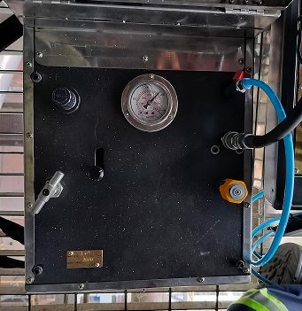
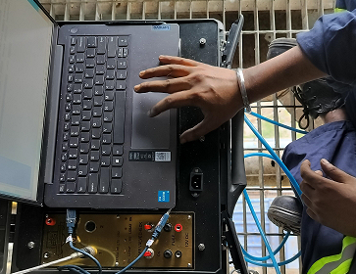
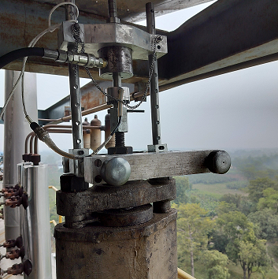
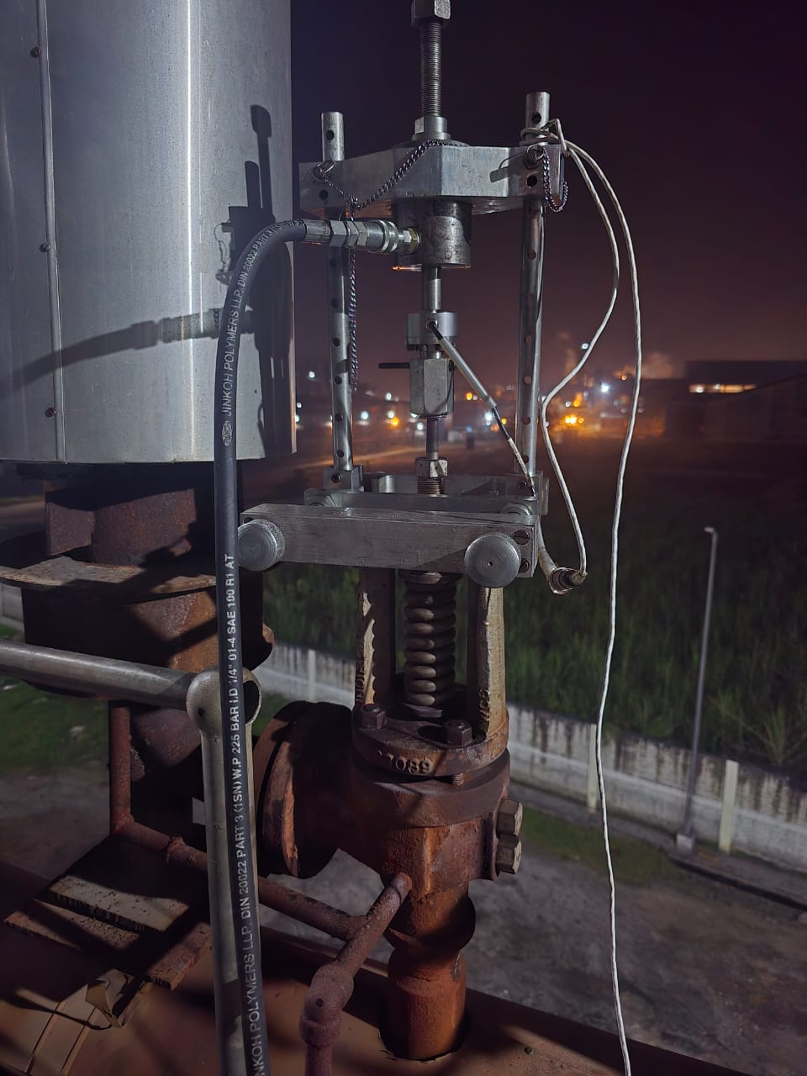
Boiler Online Safety Valves setting work
Hydraulic Force Buildup Machine
Pressure Monitor
Fixture mounted on safety valve

Slide 68
Online Boiler Safety Valves setting data
M/s EKA - PRESS TECHNO SERVICES PVT. LTD. SREE DURGA PALLY, P.O - NABAPALLY, BARASAT, KOL - 700126
SL. NO. | DATE | MAKER NAME / VALVE ID | INITIAL SET PRESS. (Kg/cm²) | DESIGN SET PRESS. (Kg/cm²) | APPLIED FORCE (kgf) | SEAT AREA (cm²) | DIFF. PRESS. (Kg/cm²) | LINE PRESS. (Kg/cm²) | FINAL SET PRESS. (Kg/cm²) | Remarks
150 TPH BOILER
1 | 27-Oct-2025 | BHEL / 85 SH SV | 109.63 | 115.00 | 309.00 | 15.45 | 20.00 | 95.00 | 115.00 | No adjustment.
2 | 27-Oct-2025 | BHEL / A1910/116 DRUM SV | 127.47 | 131.00 | 658.00 | 27.44 | 23.98 | 105.00 | 128.98 | Screwed 1.5 flat.
3 | 27-Oct-2025 | BHEL / A1910 /115 DRUM SV | 126.52 | 130.00 | 634.00 | 27.44 | 23.10 | 104.80 | 127.90 | Screwed 3 flat.
70 TPH BOILER
4 | 27-Oct-2025 | CROSBY / 96-1103 DRUM SV | 49.48 | 51.30 | 872.00 | 17.26 | 50.52 | 0.00 | 50.52 | No adjustment.
5 | 27-Oct-2025 | CROSBY / 96-1105 DRUM SV | 50.41 | 51.65 | 892.00 | 17.26 | 51.68 | 0.00 | 51.68 | Screwed 1 flat.
35 TPH BOILER
6 | 27-Oct-2025 | CROSBY / 20197008 SH SV | 48.78 | 48.90 | 457.00 | 9.34 | 48.92 | 0.40 | 49.32 | Screwed 1 flat.

Slide 69
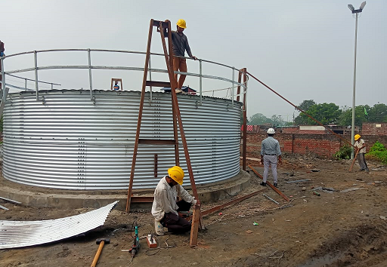
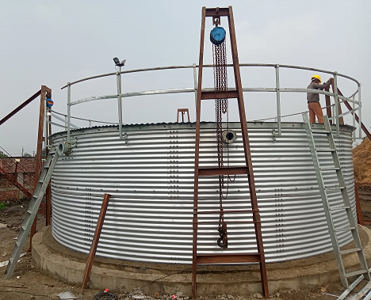
ZN- AI Tank installation Work Under Progress
Tank installation work completed approx.- 30%

Slide 70
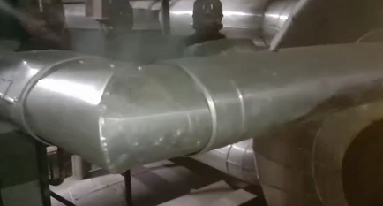
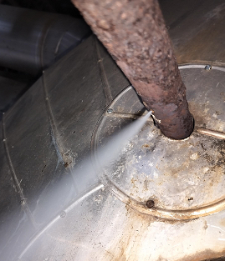
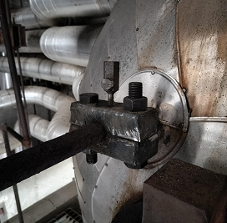
150TPH Boiler Online sealing work
Steam observed
After insulation removing
Leakage arresting with clamp
A pin hole leak was observed at the welding joint of the Hydra step level transmitter line on the boiler main steam drum. Immediate action was taken, and online leakage arresting work was successfully carried out without any interruption to boiler operation.

Slide 71
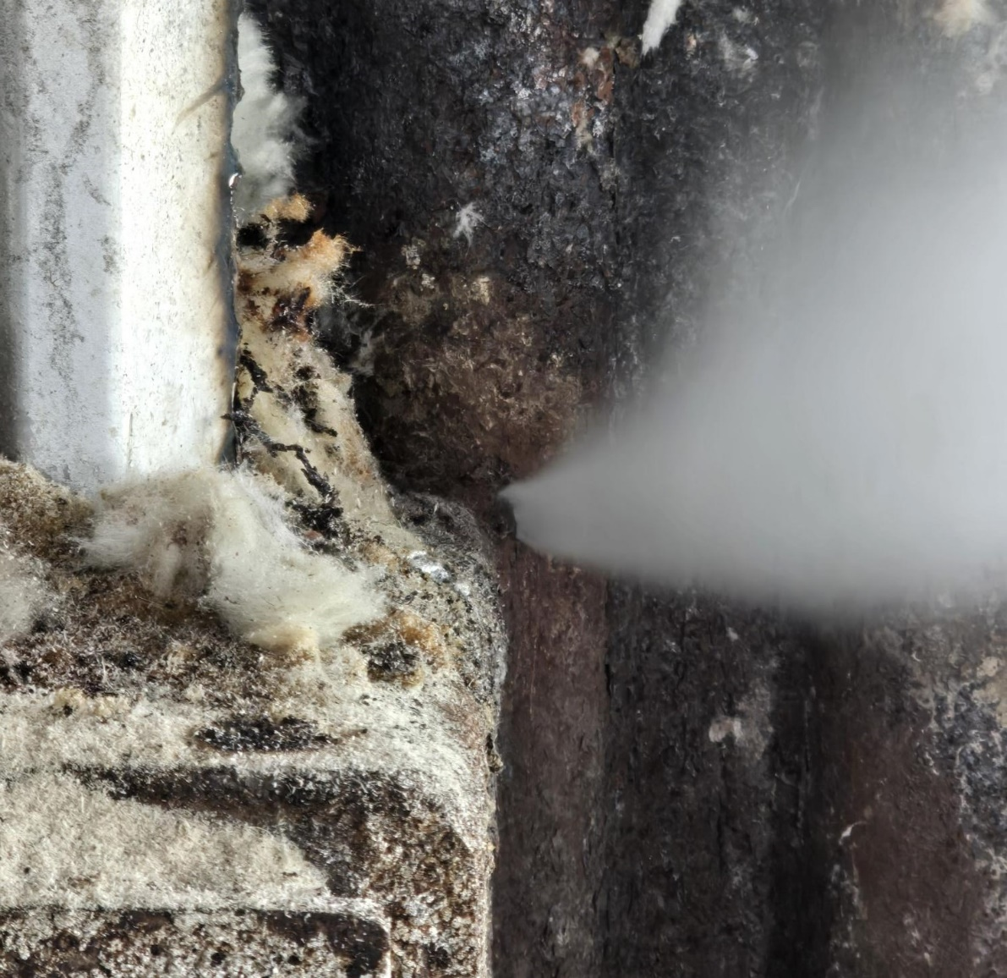
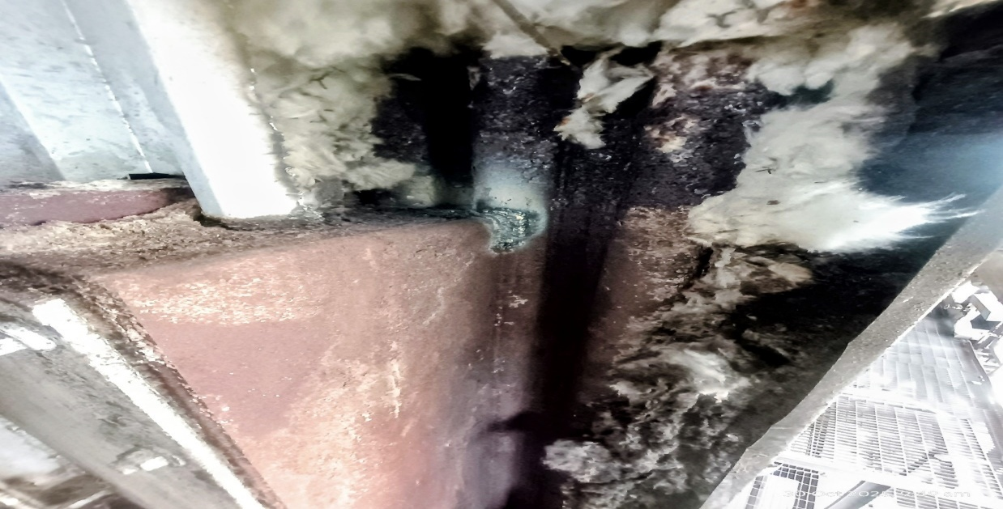
FORCED OUTAGE REPORT OF 4.0 MW TG SET DATED 30.10.2025 (SS2025-26/PP-01)
Incident Description: On Dated 30/10/25 at 07:40 AM leakage observed from welding joint of seal box (bagasse feeder) with water panel near 1nd pass.
Cause: Welding of seal box done with water panel tube which crack under thermal stress during thermal expansion.(Fatigue failure).
Action: Boiler Shutdown taken for corrective action at 8:40 AM on dated 30/10/25.
After boiler firing done at 10:00 AM. Turbine Sync with grid at 11:40 AM.
Equipment Down time: 03 HRS

Slide 72
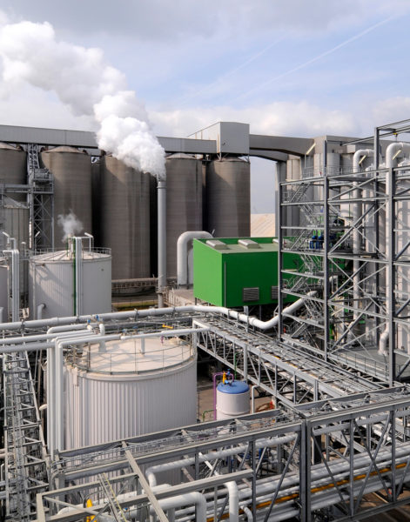
DISTILLERY UNIT

Slide 73
Physical / General Plant observations-
Plants has been started at 11.30 Am on dated 30.10.2025 after scheduled cleaning & maintenance.

Slide 74
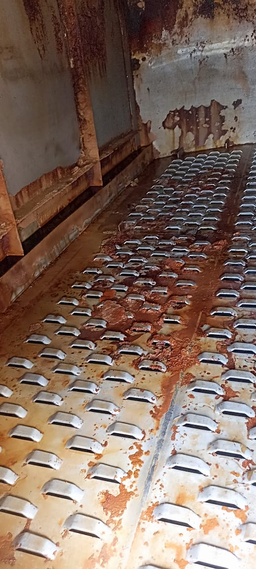
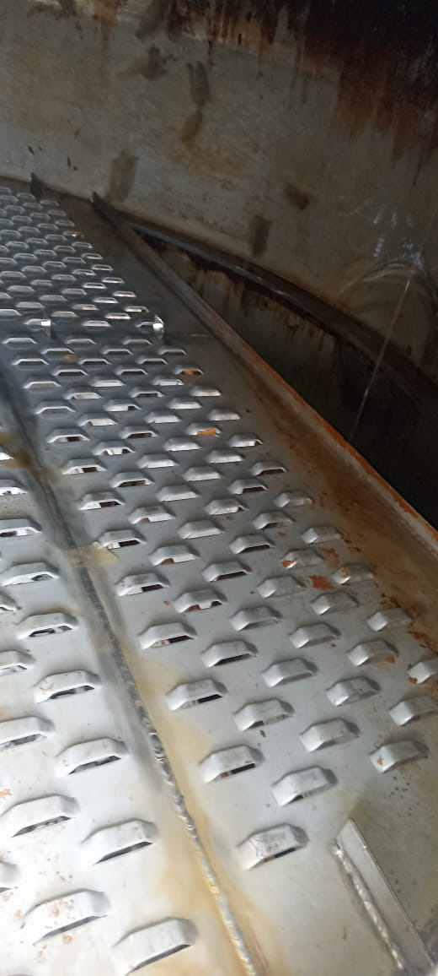
DISTILLATION SECTION
Analyser column grid tray
Before Cleaning
After Cleaning

Slide 75
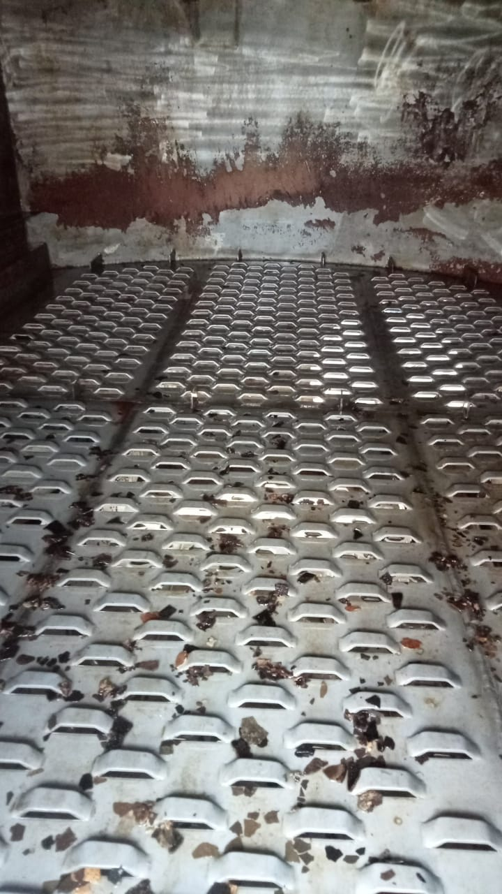
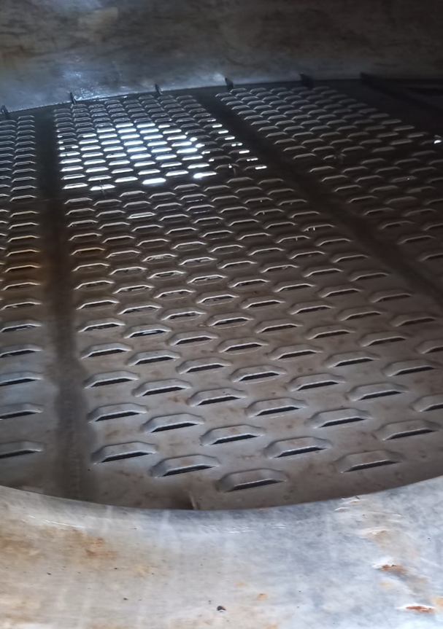
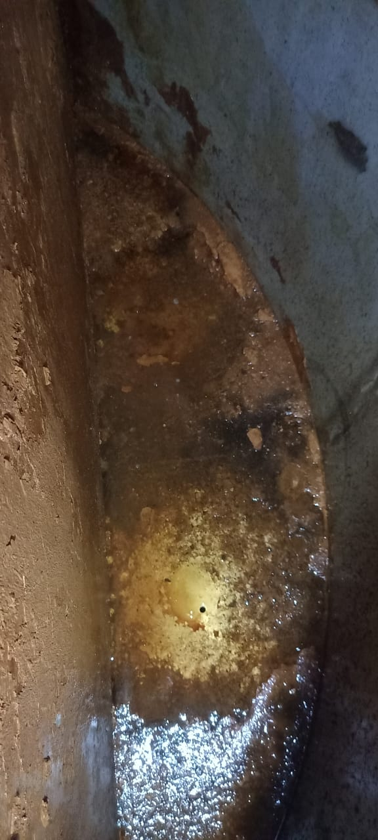
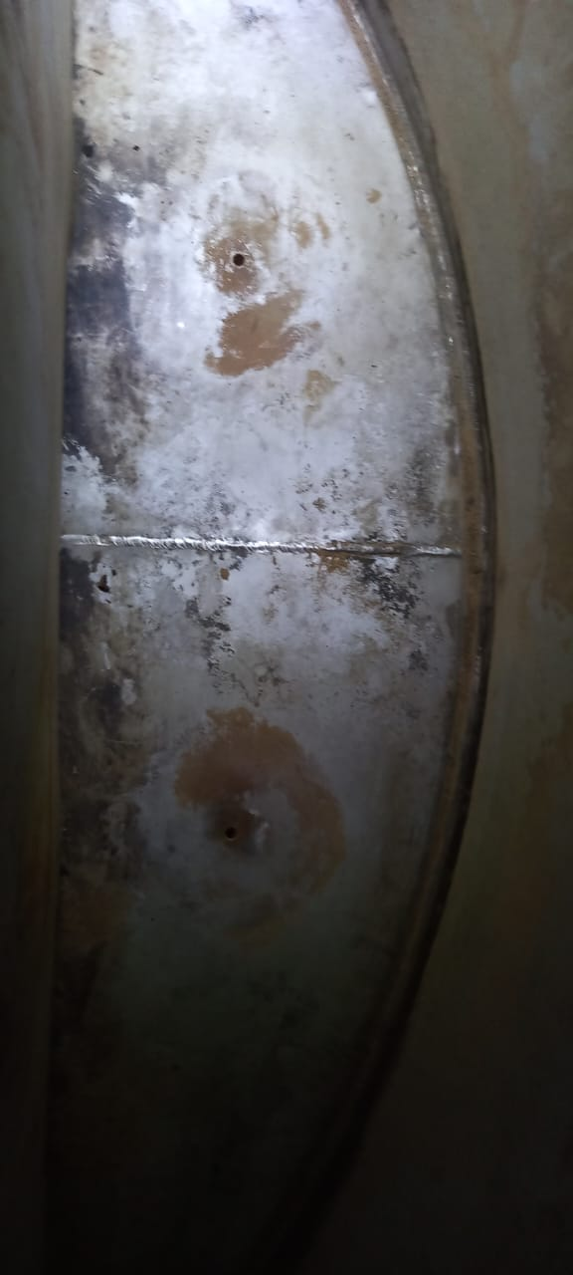
DISTILLATION SECTION
Analyser column(grid tray & down comers)
Before Cleaning
After Cleaning

Slide 76
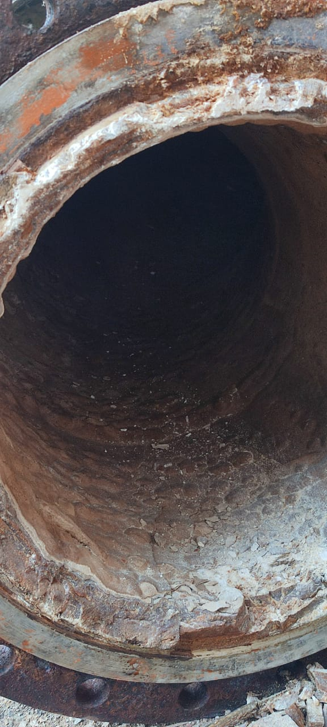
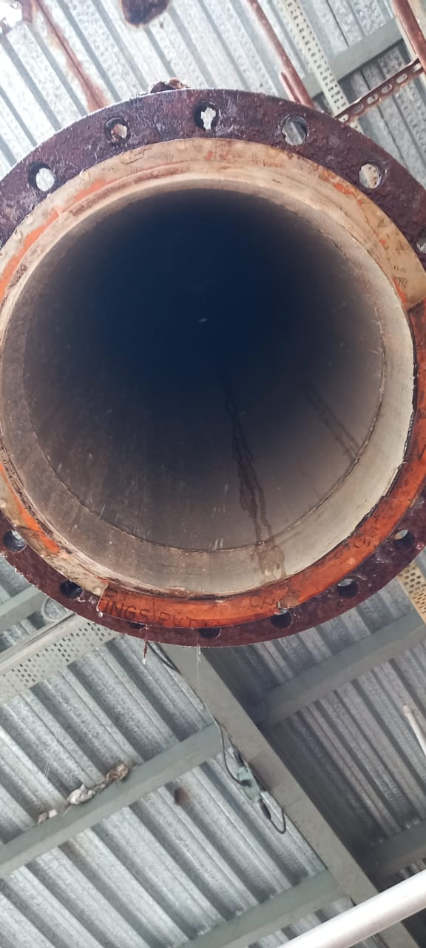
Evaporation Section
VLS0-08 circulation line cleaning status
Before cleaning
After cleaning

Slide 77
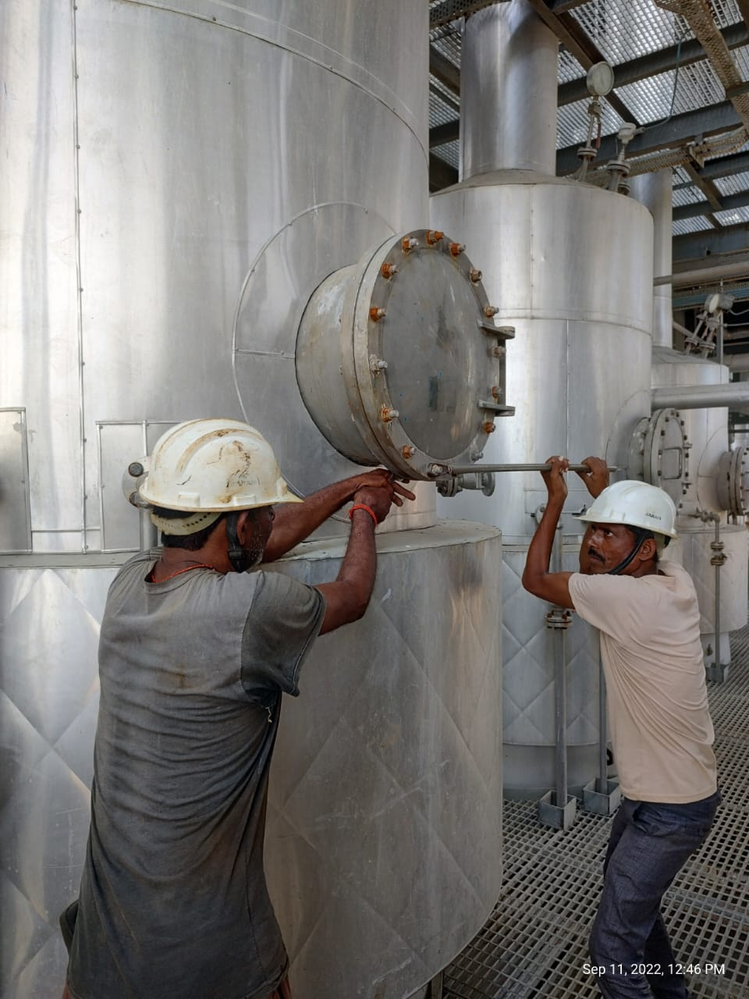
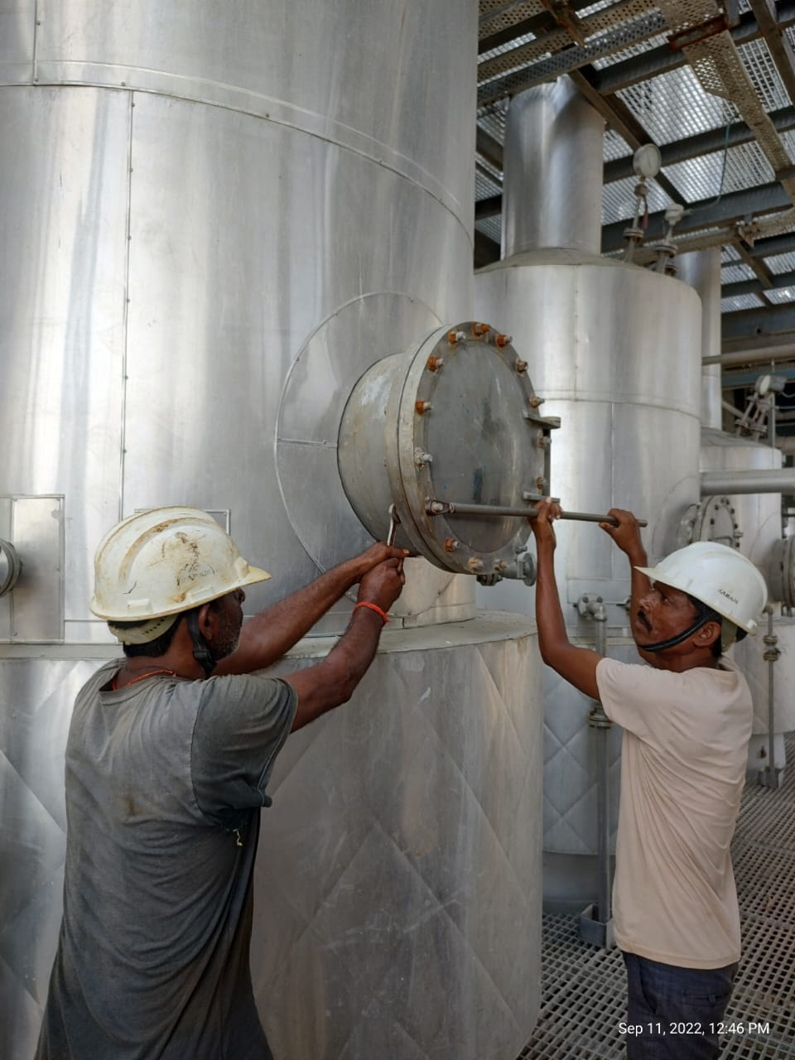
Falling Film 02 &03 Vapour liquid separator

Slide 78
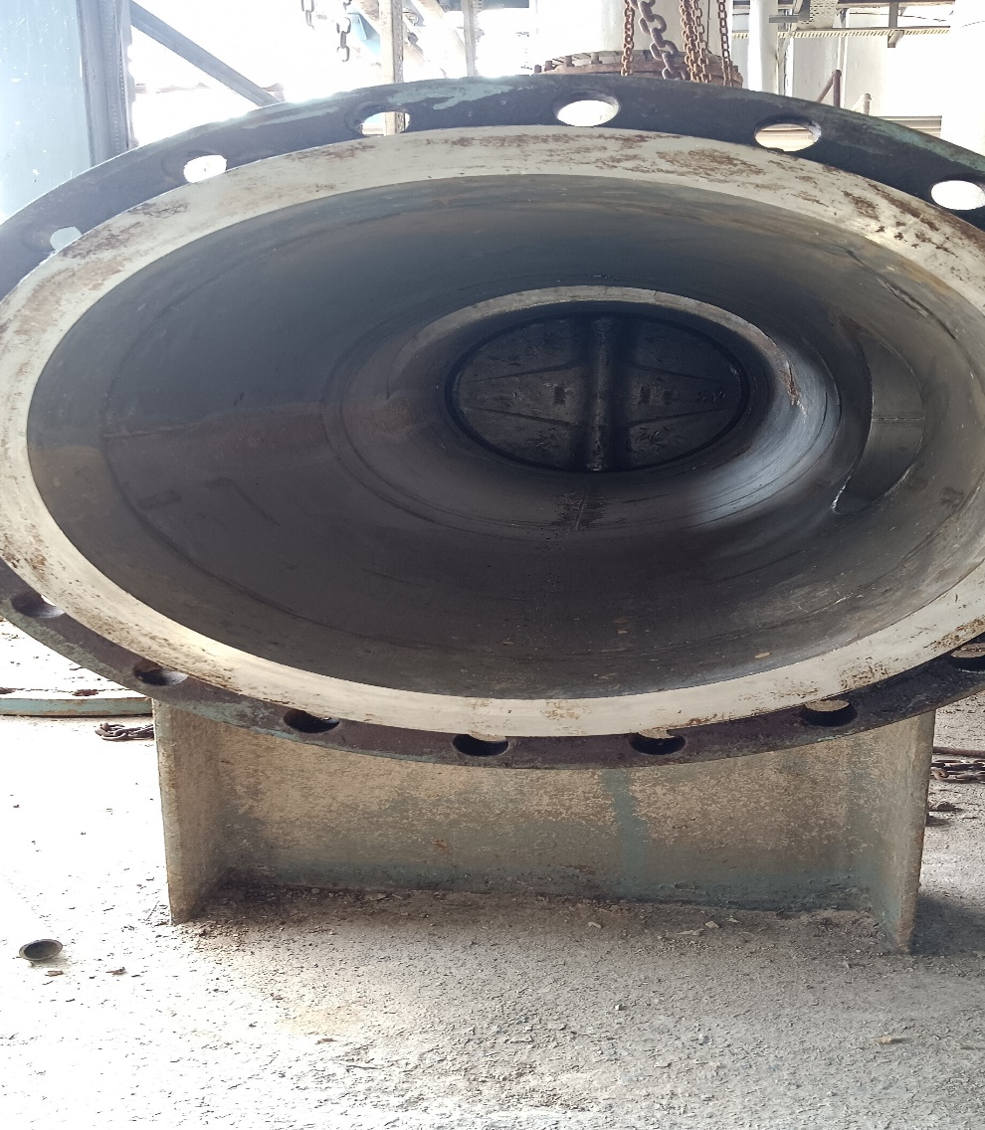
Falling Film 02 Vapour liquid separator & MEE Header
EVAPORATION SECTION

Slide 79
Weekly Performance Snapshot - Distillery
S.N | Capacity Utilization | Target | Current Week | Last Week | Till Date
1 | Total Production (Lakh Liters) | 8.40 | 1.86 | 1.38 | 9.60
4 | Downtime (Hrs.) |  | 132.50 | 133.50 | 492.57
5 | Average Ethanol Prodn./Day (Lakh Liters) | 1.20 | 1.26 | 0.960 | 0.90
 | Efficiency
6 | Ethanol Recovery – Syrup (BL/Qtl Cane) | 7.60 | 5.97 |  | 5.97
7 | Ethanol Recovery – BH (BL/Qtl) | 31.5 | - | 28.22 | 28.17
8 | Ethanol Recovery – Syrup (BL/Qtl) | - | 31.05 |  | 31.05
7 | Fermentation Efficiency (%) | 91.5 | 91.03 | 90.71 | 90.68
9 | Distillation Efficiency (%) | 98.5 | 98.63 | 98.75 | 98.67
10 | Steam consumed (Kg/BL) | 4.1 | 4.30 | 4.38 | 4.48
11 | Power consumed (KWH/BL) | 0.528 | 0.509 | 0.627 | 0.698
 | Feedstock Quality
11 | Feed Stock | B-Heavy | Syrup | B-Heavy | Syrup/B-heavy
12 | Total Reducing Sugar % |  | 55.60 | 52.50 | 53.06
13 | Fermentable Sugar % |  | 53.60 | 48.82 | 49.69
14 | UFS % |  | 2.00 | 3.68 | 3.37
79

Slide 80
Weekly Performance Snapshot On B-Hy Distillery
S.N | Capacity Utilization | Target | Current Week | Last Week | Till Date
1 | Total Production (Lakh Liters) | 8.40 | 1.86 | 1.38 | 7.73
4 | Downtime (Hrs.) | 0 | 132.50 | 133.50 | 360.07
5 | Average Ethanol Prodn./Day(Lakh Liters) | 1.20 | 1.26 | 0.96 | 0.84
 | Efficiency
6 | Ethanol Recovery – Syrup (BL/Qtl Cane) | - | 5.97 |  | -
7 | Ethanol Recovery – BH (BL/Qtl) | 31.50 | - | 28.22 | 28.17
8 | Ethanol Recovery – CH (BL/Qtl) | - | 31.05 |  | -
7 | Fermentation Efficiency (%) | 91.5 | 91.03 | 90.71 | 90.60
9 | Distillation Efficiency (%) | 98.5 | 98.63 | 98.75 | 98.68
10 | Steam consumed (Kg/BL) | 3.90 | 4.30 | 4.38 | 4.48
11 | Power consumed (KWH/BL) | 0.528 | 0.509 | 0.627 | 0.744
 | Feedstock Quality
11 | Feed Stock | B-Heavy | Syrup | B-Heavy | B-heavy
12 | Total Reducing Sugar % |  | 55.60 | 52.50 | 52.50
13 | Fermentable Sugar % |  | 53.60 | 48.82 | 48.83
14 | UFS % |  | 2.00 | 3.68 | 3.67
80

Slide 81
Last 03 Months Performance Snapshot - Distillery
S.N | Capacity Utilization | Oct.-2025 | Oct-2024
1 | Total Production (Lakh Liters) | 1.86 | 1.64
4 | Downtime (Hrs.) | 492.57 | 0
5 | Average Ethanol Prodn./Day (Lakh Liters) | 1.26 | 1.09
 | Efficiency
6 | Ethanol Recovery – Syrup (BL/Qtl Cane) | 5.97 | 6.93
7 | Ethanol Recovery – BH (BL/Qtl) | - | -
8 | Ethanol Recovery – Syrup (BL/Qtl) | 31.05 | 32.08
7 | Fermentation Efficiency (%) | 91.03 | 92.02
9 | Distillation Efficiency (%) | 98.63 | 98.71
10 | Steam consumed (Kg/BL) | 4.30 | 4.22
11 | Power consumed (KWH/BL) | 0.509 | 0.583
 | Feedstock Quality
11 | Feed Stock | Syrup | Syrup
12 | Total Reducing Sugar % | 55.60 | 54.95
13 | Fermentable Sugar % | 53.60 | 54.74
14 | UFS % | 2.00 | 0.21
81

Slide 82
Key Operational Parameters
Particulars | Current Week | Last Week | Last year Week | Till Date
 | SS 25-26 | SS 25-26 | SS 24-25 | SS 25-26 | SS 24-25
Feed Stock | Syrup | B-Heavy | B-Heavy | Syp/B-Heavy | Syrup
Average Ethanol Prodn. / Day | 125894.0 | 96019.0 | 109084.0 | 89943.0 | 109084.0
Capacity Utilization | 100.72 | 76.82 | 87.27 | 71.95 | 87.27
Ethanol Prodn. ( In BL) | 186322.80 | 138267.60 | 163626.20 | 959690.40 | 163626.20

Slide 83
Key Operational Parameters
Particulars | Weekly |  | Till Date
 | SS 25-26 | SS 24-25 | SS 25-26 | SS 24-25
Feed Stock | Syrup | Syrup | Syp/B-Heavy | Syrup
B-heavy molasses Utilized (In Qtl) | 6000 | 5100 | 33450 | 5100
Ethanol Prod. BL / Qtl | 31.05 | 32.08 | 28.69 | 32.08
Total Reducing Sugar % | 55.60 | 54.95 | 53.06 | 54.95
Fermentable Sugar % | 53.60 | 54.74 | 49.69 | 54.74
UFS % | 2.0 | 0.21 | 3.37 | 0.21
Distillation Efficiency | 98.63 | 98.71 | 98.67 | 98.71
Fermentation Efficiency | 91.03 | 92.02 | 90.68 | 92.02

Slide 84
Key Operational Parameters
Sugar Season | 2025-26
Particulars | Budgeted (Week) | Achieved (Week) | Budgeted (To date) | Achieved (To date)
Feed Stock | Syrup |  | Syrup/B-heavy
Ethanol Prodn. ( In BL) | 840000 | 186322.80 | 3720000 | 959690.40
Steam consumed in (MT) | 3444.0 | 800.90 | 15252.0 | 4263.40
Steam consumed Kg/BL | 4.10 | 4.30 | 4.10 | 4.48
Power consumed in (Kwh) | 443520 | 94800 | 1964160.0 | 670200
Power consumed Kwh/BL | 0.528 | 0.509 | 0.528 | 0.698

Slide 85
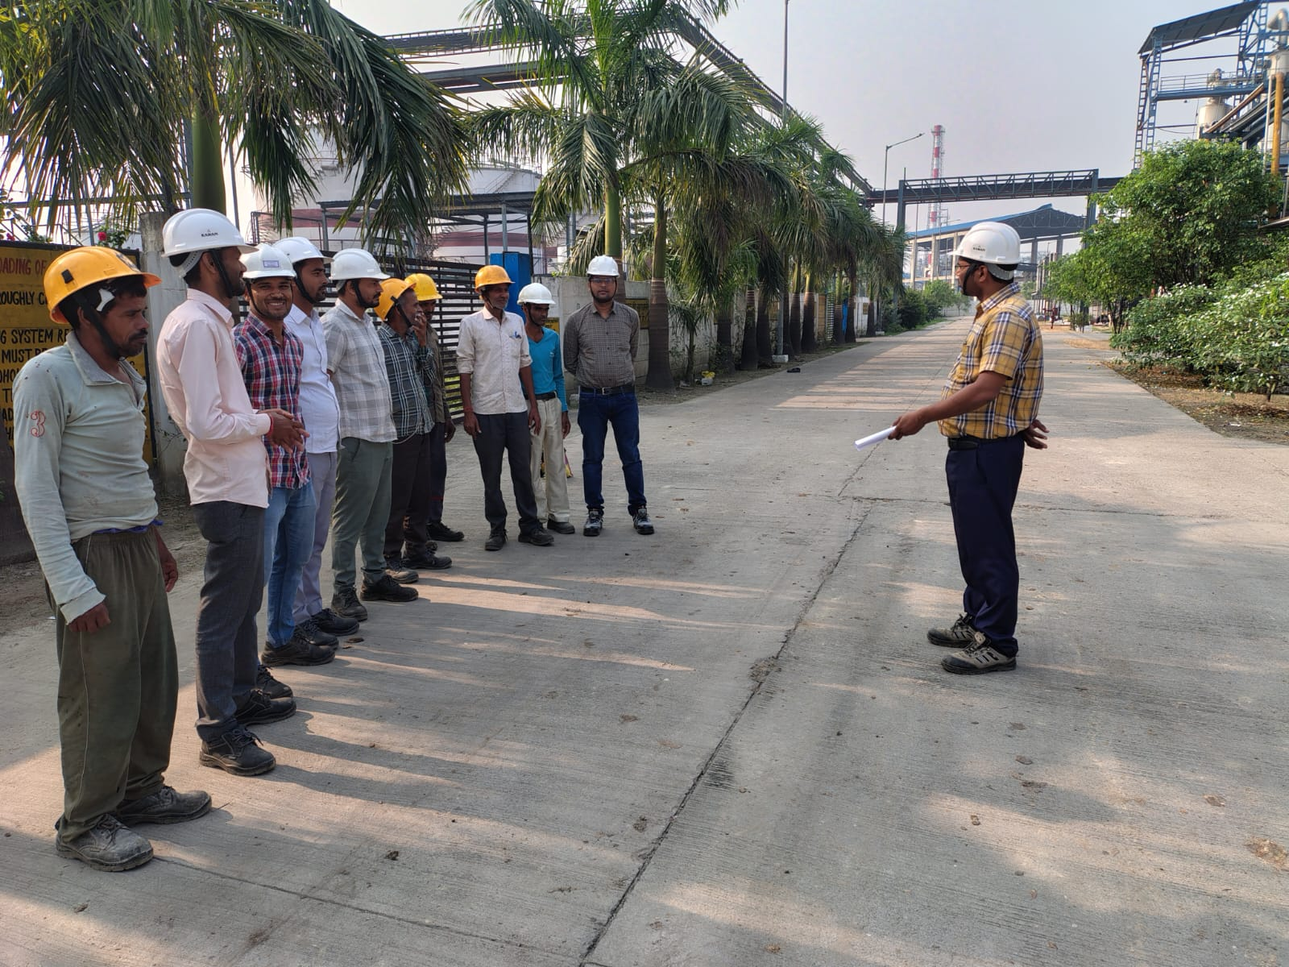
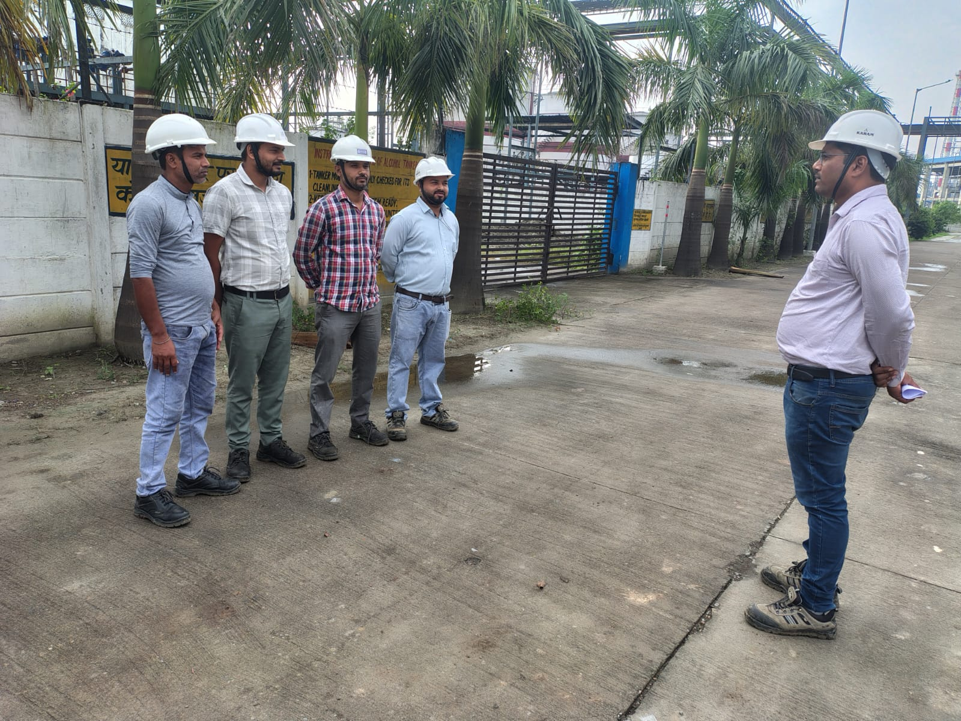
TBT

Slide 86
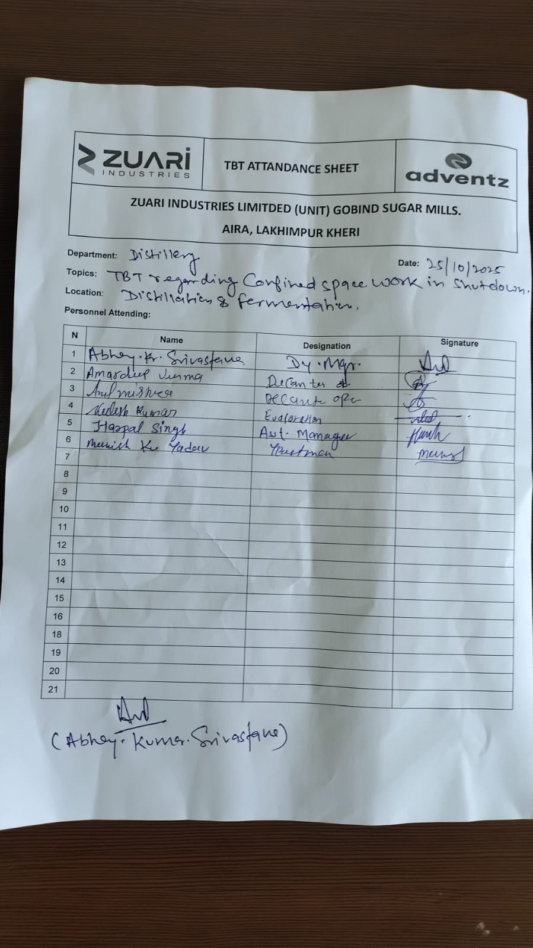
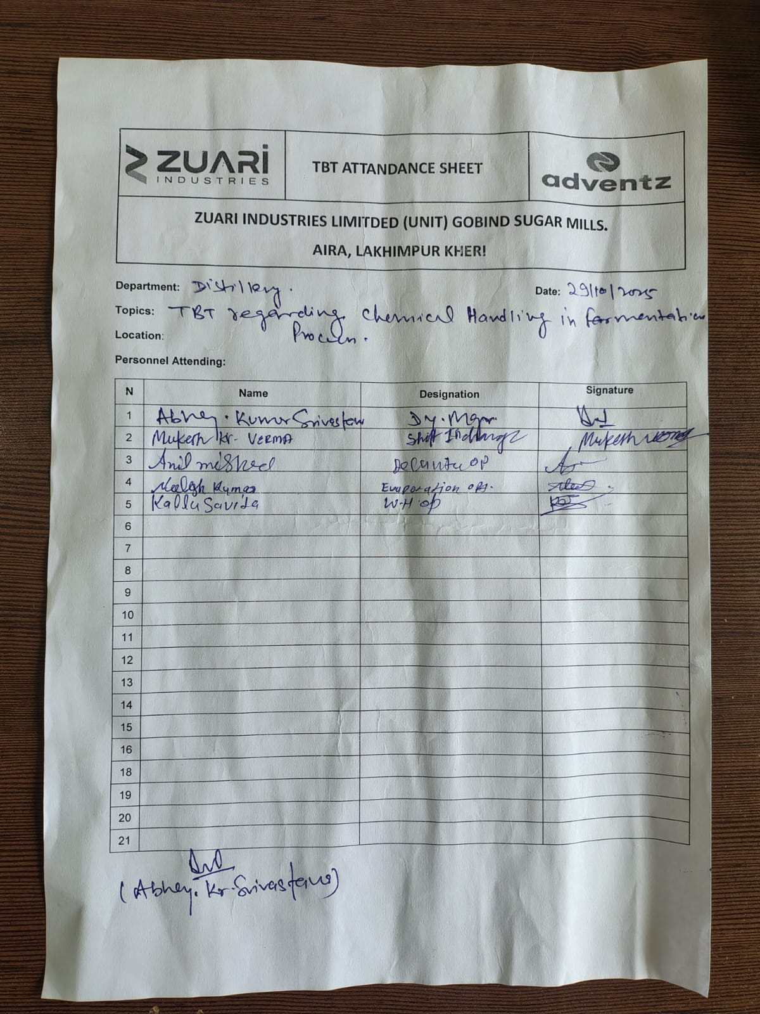
TBT Attendance

Slide 87
Near Miss or Hazardous Activity Report
HAZARDS OBSERVATION - DISTILLERY
S.N | DATE | HAZARDOUS ACTIVITY/ OBSERVATION | LOCATION | ACTION REQUIRED/ TAKEN | TARGET DATE | RESPONSIBILITY | STATUS
1. | 25/10/2025 | During cleaning of wash holding tank in fermentation house some sludge spread on floor . | Fermentation House | Instruct to supervisor to clean floor immediately . | Immediate | Mr Harpal Singh | Completed
2. | 27/10/2025 | Casual labour cleaning fermentation N-pit doing without wearing face mask . | Fermentation House. | Instruct to supervisor and labour to wear face mask . | Immediate | Mr Vivek Tiwari | Completed
3. | 28/10/2025 | Contractual labours cleaning cooling tower basin without Gum boot. | Cooling Tower | Instruct to Supervisor use proper PPE,s during hazardous work . | Immediate | Mr. Vivek Bhatnagar | Completed
4. | 31/10/2025 | Small herbs and grass near main boundary . | Distillery main boundary. | Herbs & Grass cutting work has been done. | Immediate | Mr Abhay Srivastava | Completed

Slide 88
Near Miss or Hazardous Activity Report
NEARMISS - DISTILLERY
S.N | DATE | HAZARDOUS ACTIVITY / OBSERVATION | LOCATION | ACTION REQUIRED / TAKEN | TARGET DATE | RESPONSIBILITY | STATUS
1 | 25/10/2025 | While fitter was open the analyser manhole ring spanner broken.no injury occurred. | Distillation Plant | Provided new tool. | Immediate | Mr Chirag Agarwal | Completed
2 | 27/10/2025 | Pump spare placed in unsystematic manner after dismantling the pump in Distillation plant.NO injury occurred. | Distillation Plant | Instruct to fitter spare placed in systematic manner. | Immediate | Mr Avhay Kumar | Completed
3 | 28/10/2025 | PHE plate in unsystematic manner in MEE Plant after cleaning. No injury occurred. | MEE Plant | Instruct to operator to be placed in systematic. | Immediate | Mr. Mukesh Verma | Completed
4 | 30/10/2025 | MEE & Distillation Plant cleaning some debris spread near main gate during shifting by trolley. No injury occurred. | Near Main gate of Distillery | Instruct to clean . | Immediate | Mr. Vivek Tiwari | Completed

Slide 89

QUALITY CONTROL

Slide 90
Summary For Season 25-26

Slide 91
GENERAL OVERVIEW 2025-26 v/s 2024-25

Slide 92
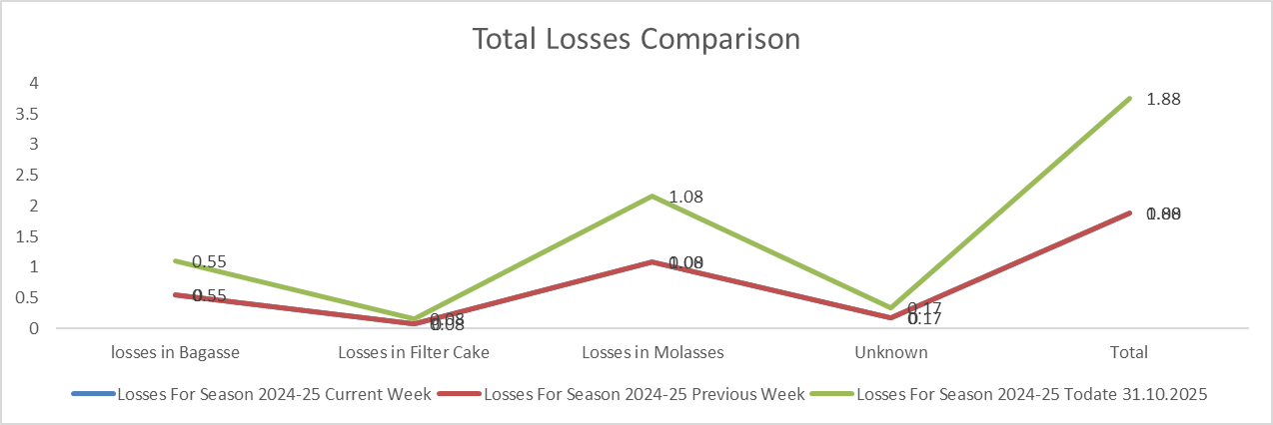
TOTAL LOSSES

Slide 93
KPI Target Vs Achieved

Slide 94
Cane Crushed Data Capacity Wise

Slide 95
Six Year Comparison

Slide 96
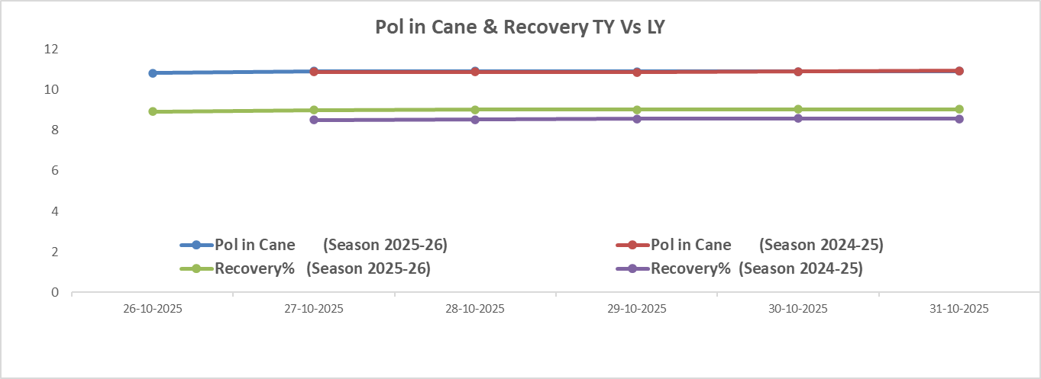
Pol in Cane Comparison

Slide 97


Thank You!

